Slide 1
Figures for GAP_PRODUCTS documentation

Slide 2

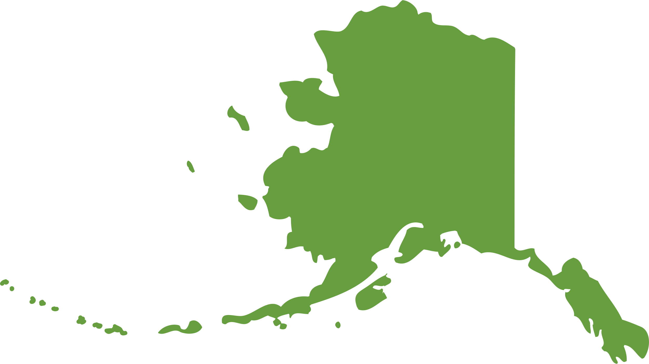
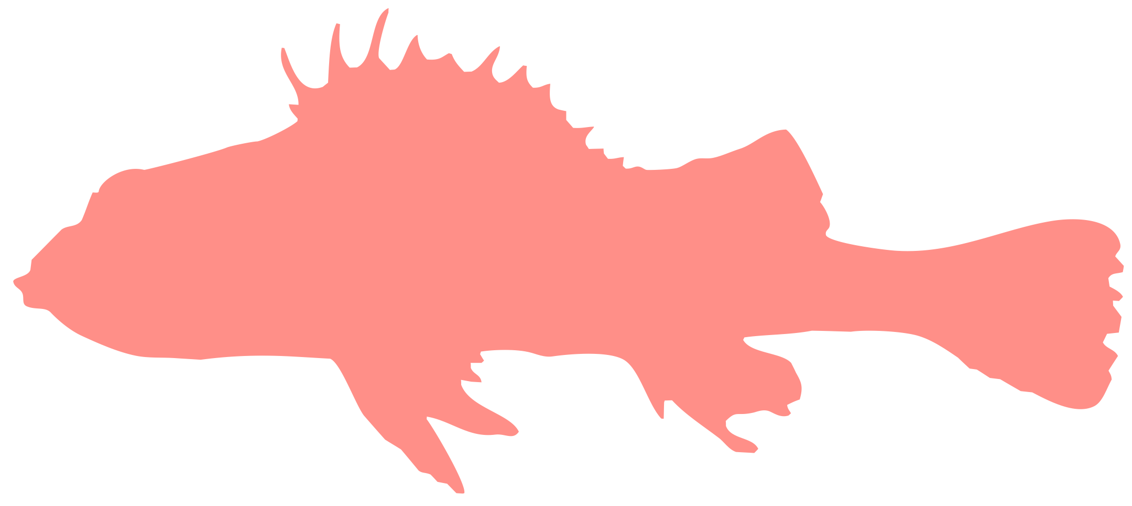


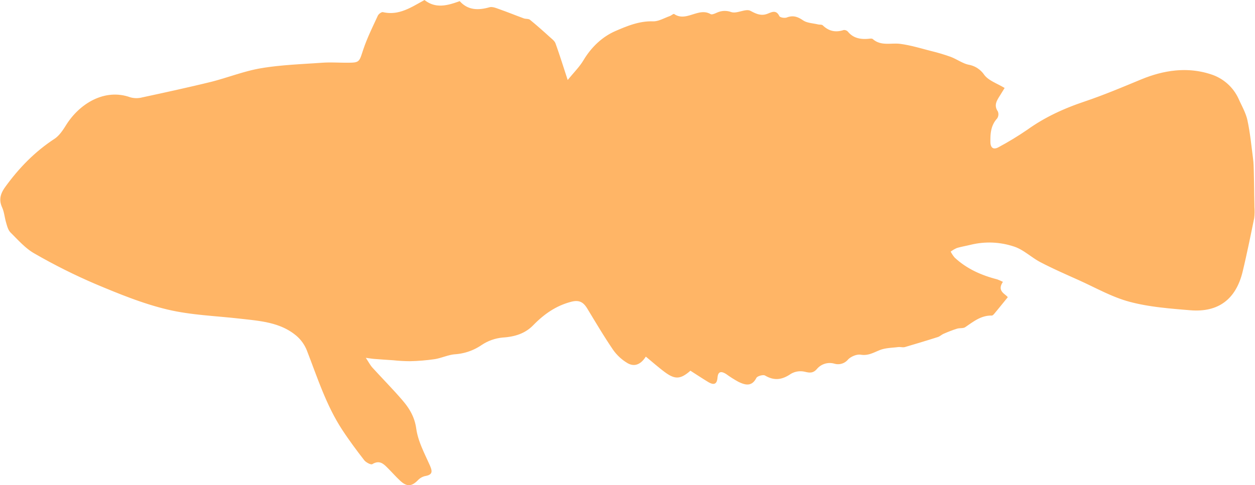












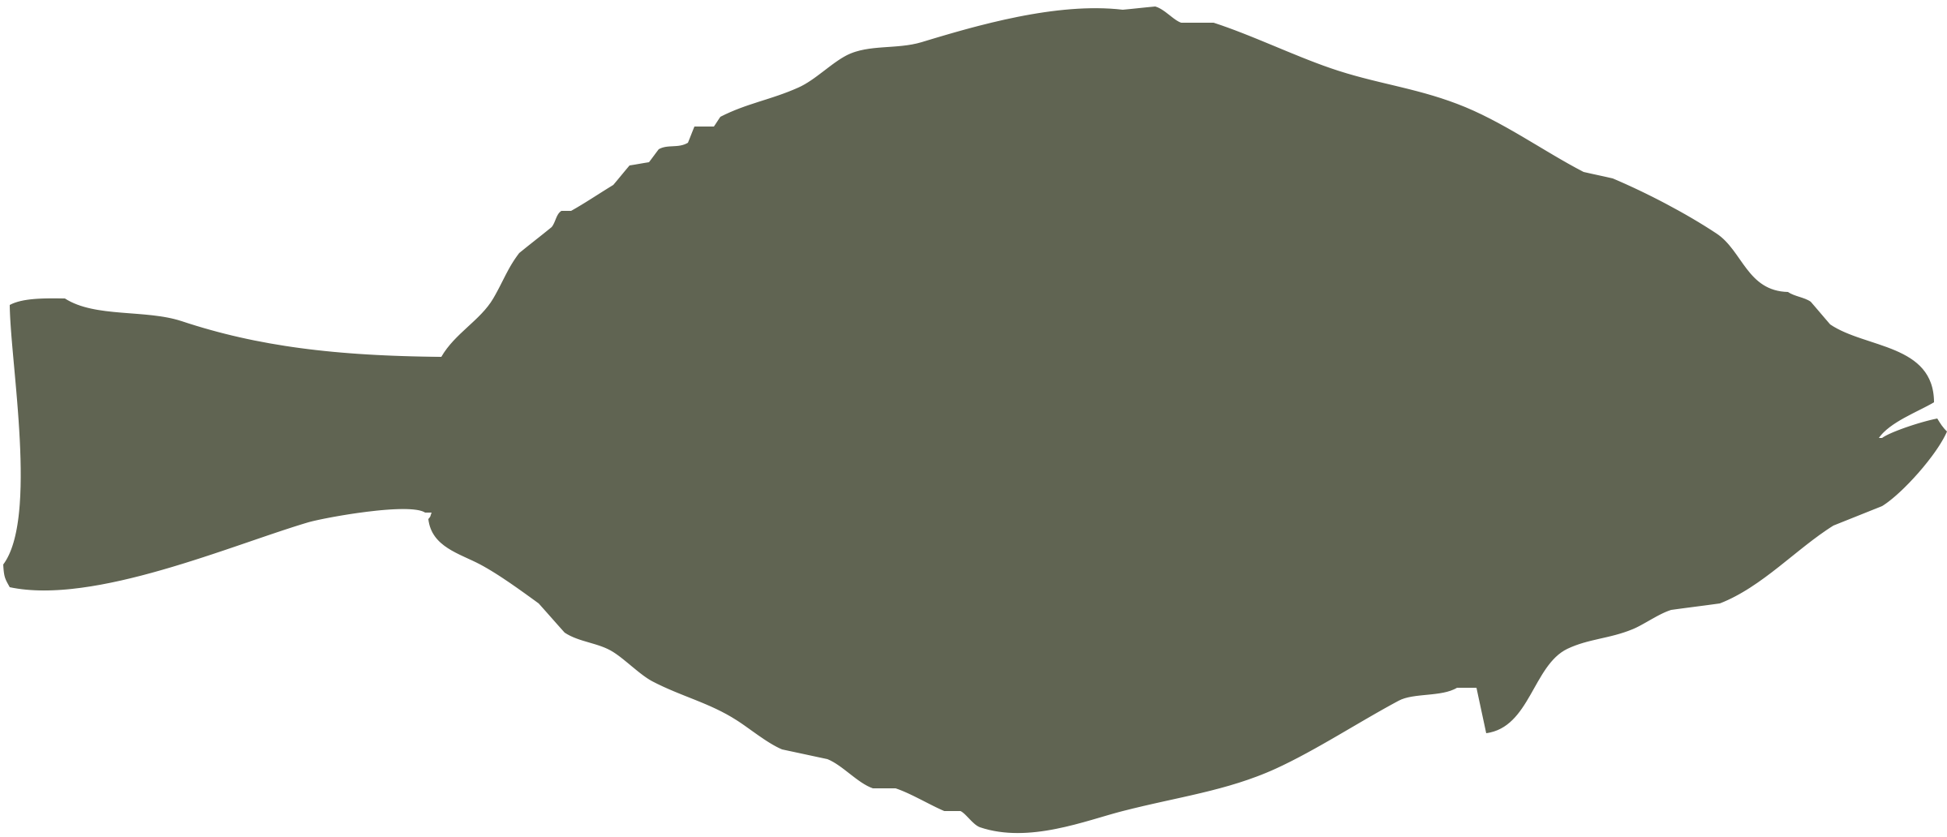

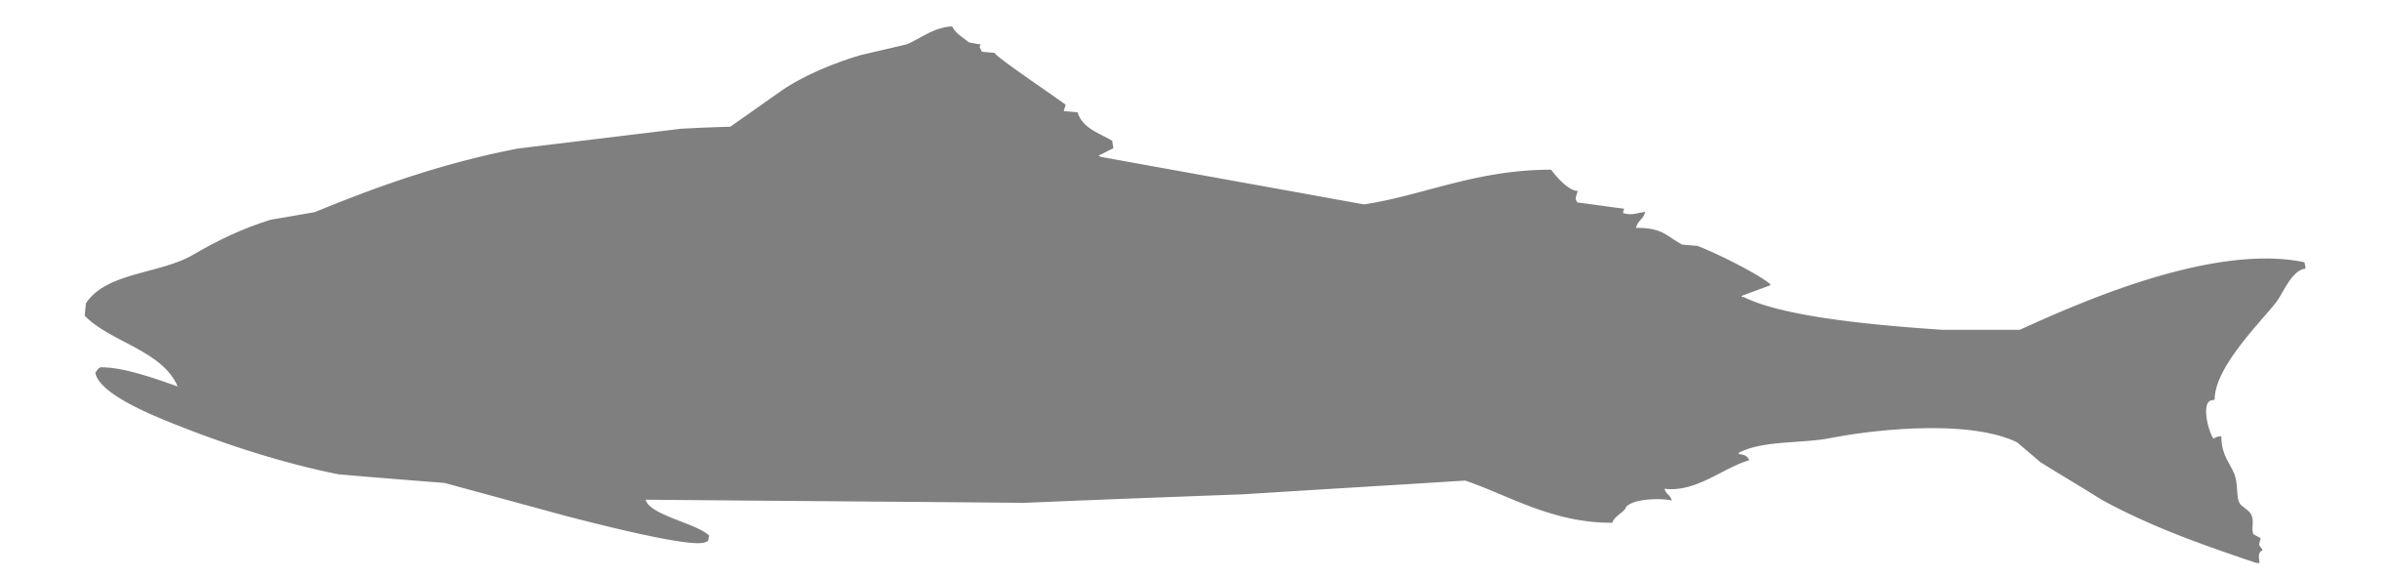


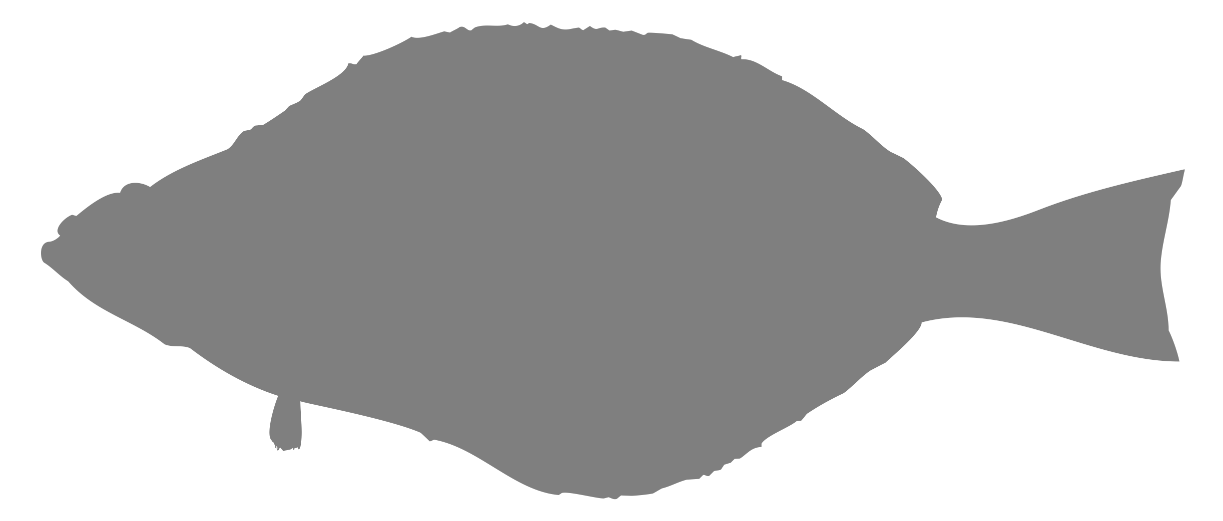
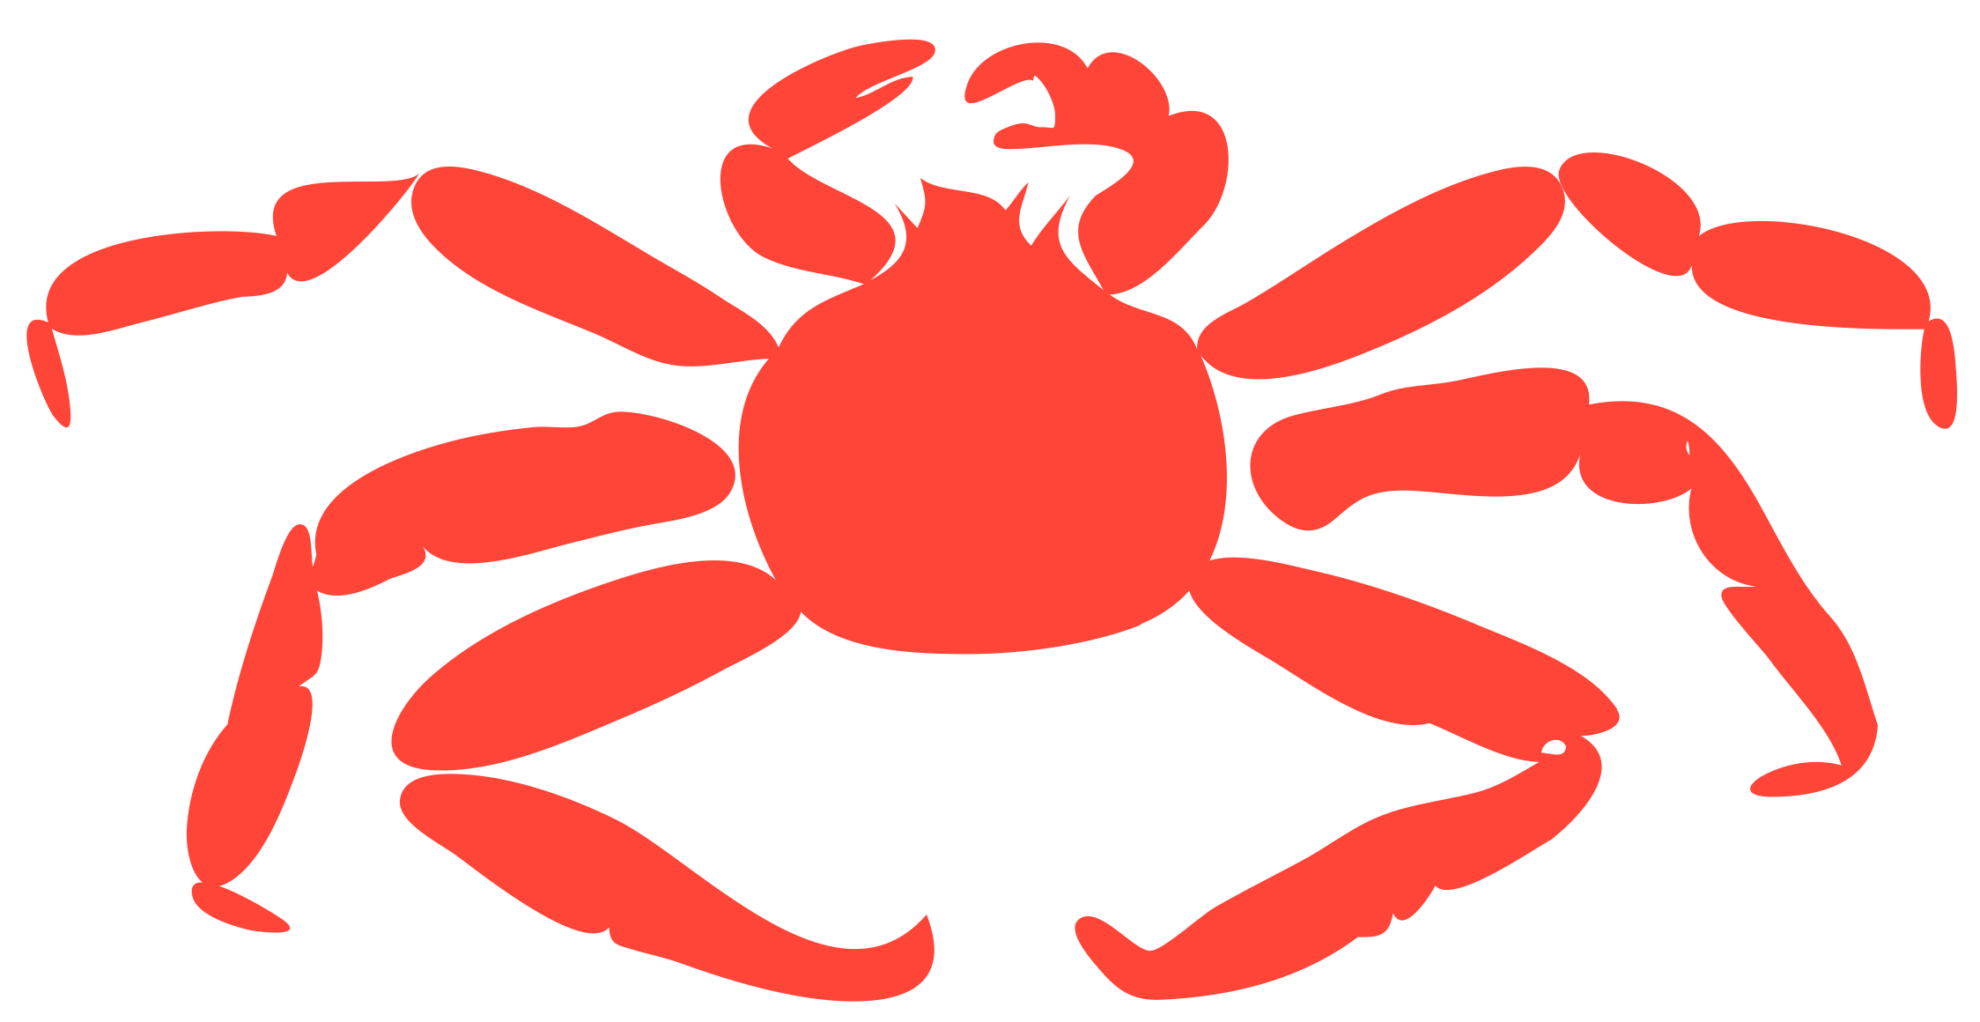


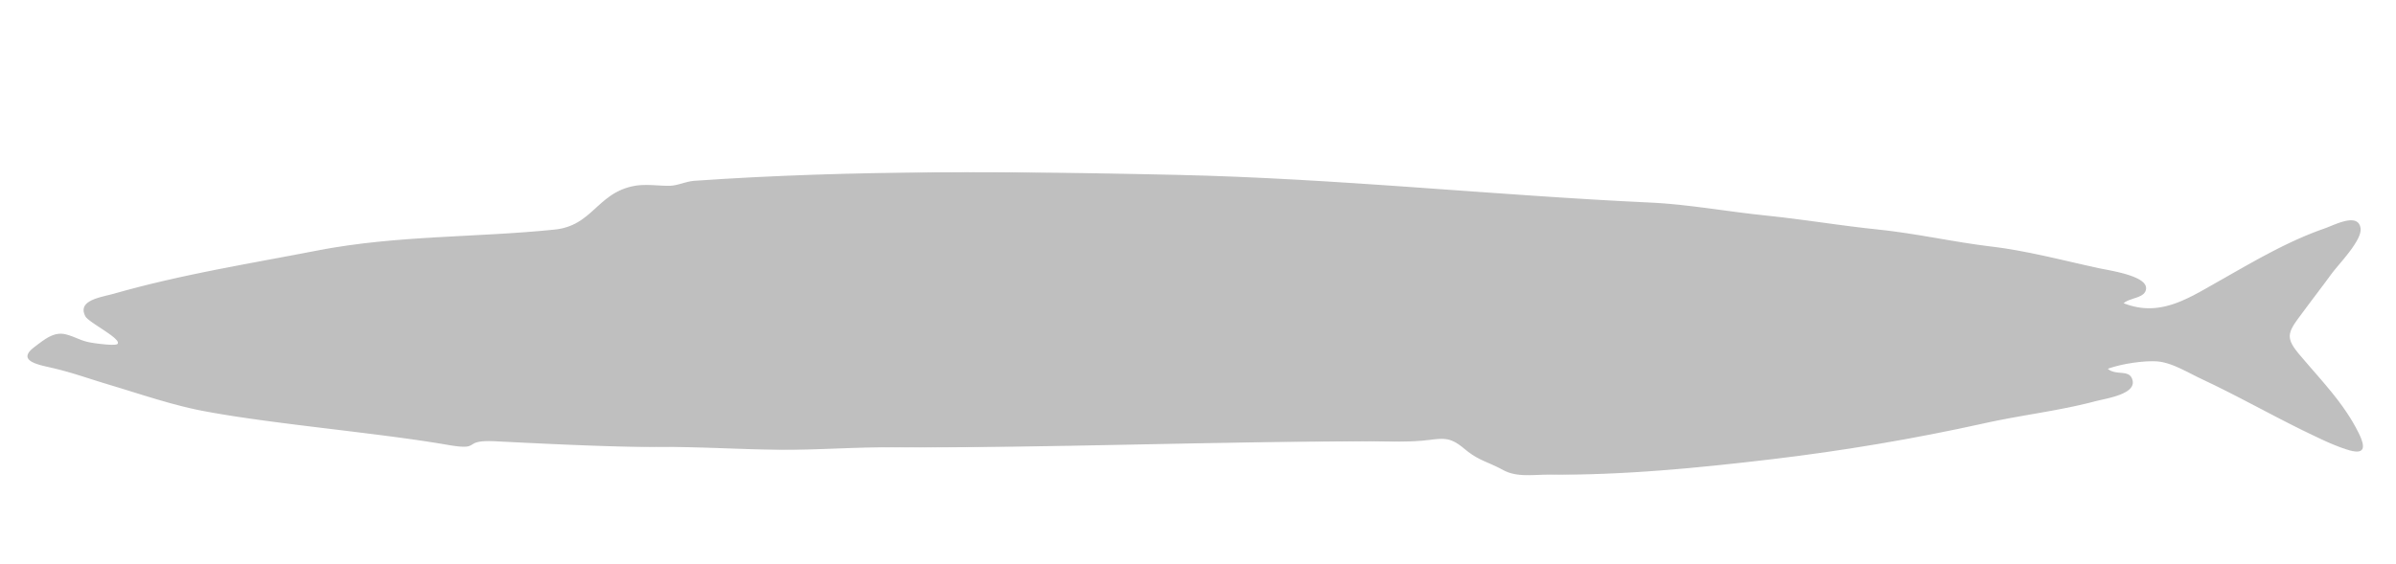



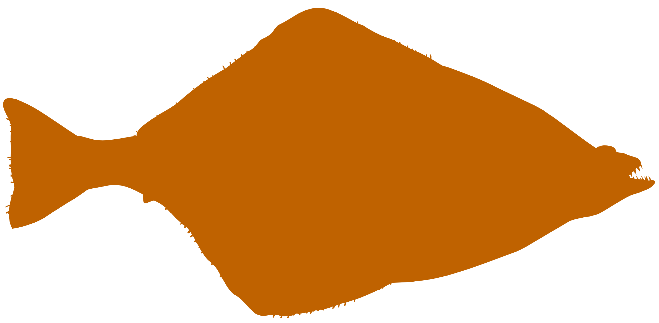



AFSC GAP Products

Slide 3


Slide 4
OLD

Slide 5
Current Workflow
NEW SCHEMA
** draft table names
CURRENT TABLE
CURRENT SCHEMA
NEW TABLE**
R ENVIRONMENT
GAP_PRODUCTS
RACEBASE
HAUL
CATCH
PROUDCTION_CPUE
LENGTH
gapindex R Package
PRODUCTION_BIOMASS
SPECIES
PRODUCTION_SIZECOMP
DESIGN_TABLE
SPECIMEN
STRATUM
PRODUCTION_AGECOMP
STRATUM_GROUPINGS
RACE_DATA
V_CRUISES
METADATA_COLUMN
METADATA_TABLE

Slide 6
Proposed Workflow
NEW SCHEMA
CURRENT TABLE
GAP_PRODUCTS
CURRENT SCHEMA
RACEBASE
NEW TABLE
R ENVIRONMENT
PROUDCTION_CPUE
HAUL
PRODUCTION_BIOMASS
CATCH
PRODUCTION_SIZECOMP
LENGTH
PRODUCTION_AGECOMP
SPECIES
SPECIMEN
CRUISE
RACEBASE_FOSS
gapindex R Package
RACE_DATA
JOIN_CPUE_HAUL
DESIGN_TABLE
JOIN_CPUE_CATCH
STRATUM
STRATUM_GROUPINGS
[AKFIN]
METADATA_COLUMN
…
METADATA_TABLE

Slide 7
GitHub Workflow
metadata: support for table documentation
data-requests: non-standard data requests
gap_products: standard index production
gapindex
R Package
Other research and exploratory analyses
gap_bs_data_report and [goa/ai repo]: standard data reports
AKFIN data
model-based-indices: Model-based index production (ModSquad)
gap_public_data: FOSS data portal

Slide 8
Proposed Oracle Schema Workflow *schema names not final
RACE_DATA/REF Data tier 1: Reference tables that support all RACE shema. Read access to all users.
GAP_PRODUCTS
Data tier 3: Production-level tables for official use. Available to all users read-only
RACE_EDIT/ATSEA/RAW
Data tier 0-1: Tables directly from the boat. Supervisor/database manager-limited access.
RACEBASE_FOSS:
Data tier 4: Pipeline to OST. Available to all users read-only. Standard data ONLY.
gapindex R Package
RACEBASE/ RACE_DATA
Data tier 2: Cleaned internal use data. Includes nonstandard hauls, etc.
RACE_Archive Data tier NA: Stuff we are not emotionally ready to part with, but is basically useless
[AKFIN]
Data tier 4: Pipeline to AKFIN. Available to all users read-only. Data for Stock Assessments.

Slide 9
currrent * = new; italics = join
cpue_0fill
hauljoin
analysis_area
species_code
[cpue]
race_data
ref
race_base
gap_products
public (akfin/foss/gh)
affiliation
agency
…
cruise
cruisejoin
..[listing]
haul
hauljoin
species_code
[env]
performance
length
hauljoin
species_code
sex
length_class
frequency
*special_collection
cruisejoin
requester
Desc
[type]
targets
count_collected
performance
performance
description
vessel
vessel_id
…[listing]
bio_abund
cruisejoin (srvy+yr)
stratum
species_code
analysis_area
[count]
[biomass]
[abundance]
[cpue_mean]
prod data
catch
hauljoin
species_code
count
weight
taxon_conf
species_codetaxon_conf
species
species_code
…[listing]
voucher
cruisejoin
voucher_id
species_code
…
*stomach
hauljoin
species_code
sex
length_class
…
station_allocation
station
year
srvy
stratum
stratum
area
area_type
year_calc
special_collections
cruisejoin
requester
desc
targets
count_collected
specimen
cruisejoin
voucher_id
species_code
[taxonomics]
age_len_comp
cruisejoin (srvy+yr)
stratum
species_code
analysis_area
sex
comp (age/len)
value (age/len class)
abundance
len_[mean/sd] (age)
age_len_comp
cruisejoin (srvy+yr)
stratum
species_code
analysis_area
sex
comp (age/len)
value (age/len class)
abundance
len_[mean/sd] (age)
*count_field_collections
hauljoin
species_code
sex
type
desc
length_types
species_code
length_type
desc
station
station
area
area_type
year_calc
station_allocation
cruisejoin
requester
desc
targets
count_collected
Length_weight-age
species_code
[params]
desc

Slide 10
Current * = doesn’t exist yet
race_data
ref
race_base
gap_products
public (akfin/foss)
vessel
haul
catch tablet
performance
specimen tablet
net_mens
cpue_0fill
length tablet
gear_codes
station_allocation
(foss+akfin) Cpue_0fill
stomach tablet
cruise
marport sensors
haul_types
catch
marport app
stratum
akfin.bio_abund
wheelhouse
station
voucher
bio_abund
ES60
taxon_conf
species_ taxonomics
specimen
akfin.age_len_comp
light meter
photos
length
age_len_comp
length_types
shapefile, grids
*life_stages
CTD
affiliation
*age (age&growth)
*count_field_collections
length_ weight_age
*stomach (s lab)
meas_units
*special_collection
*atmospheric

Slide 12
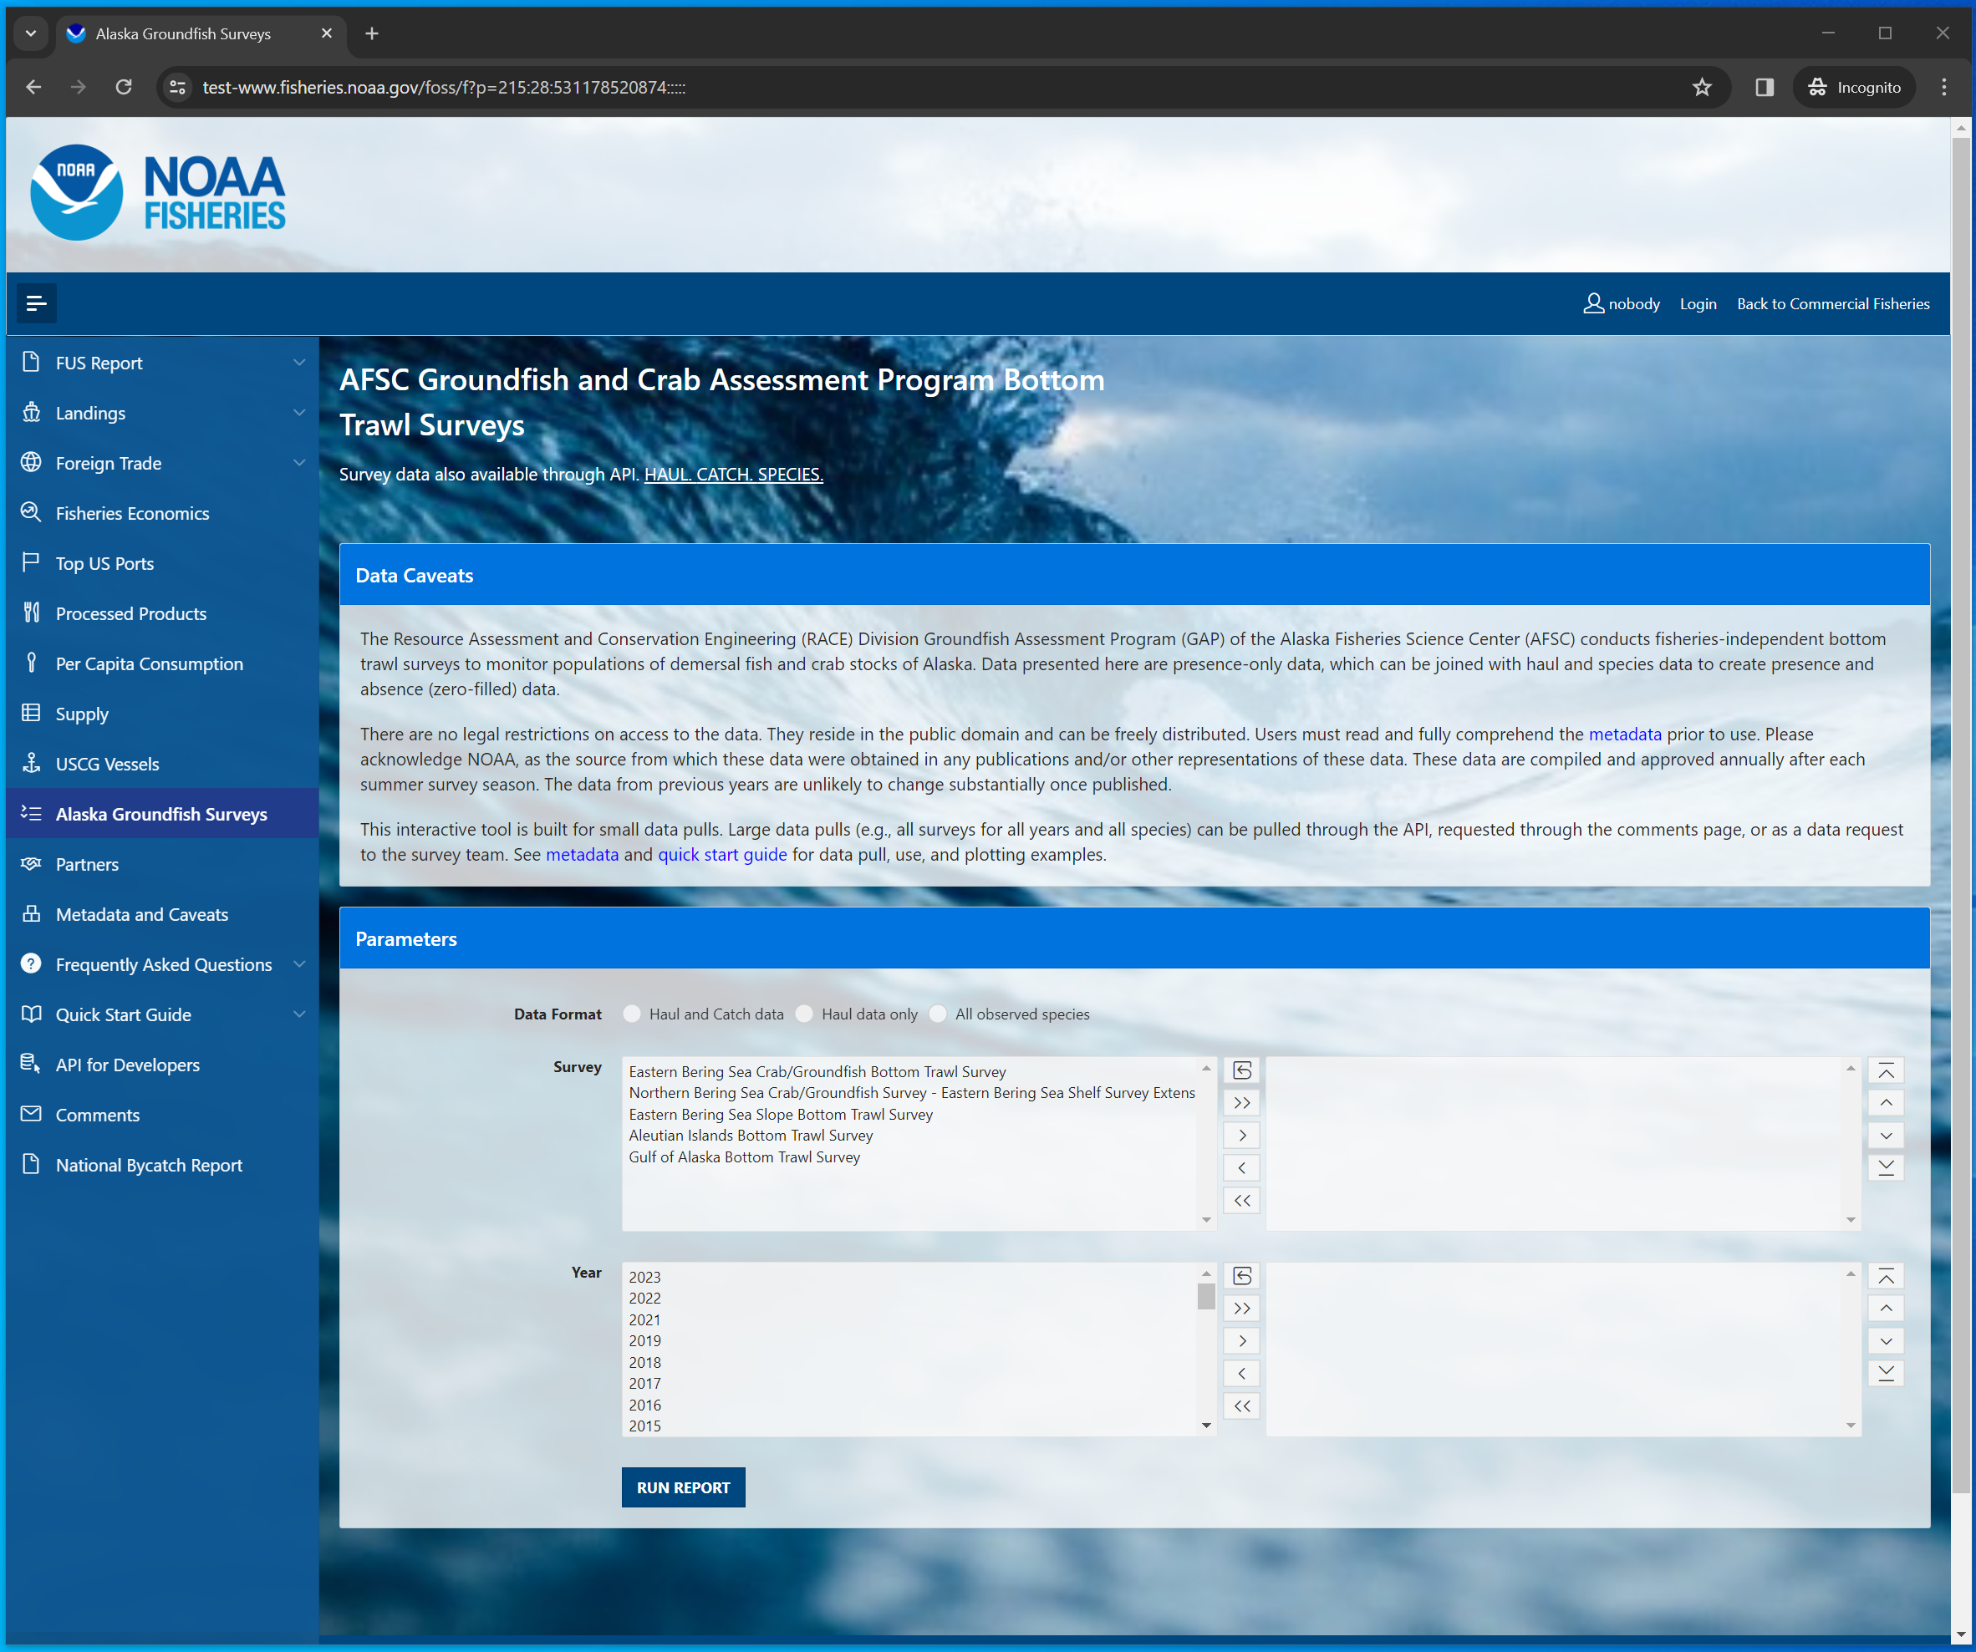
foss_1_interface.png

Slide 13
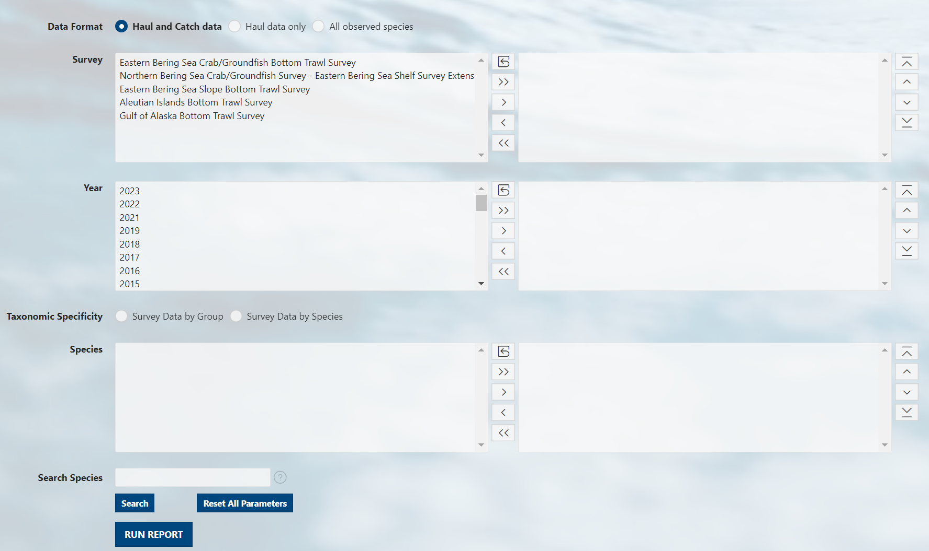
foss_1_interface_catch.png

Slide 14
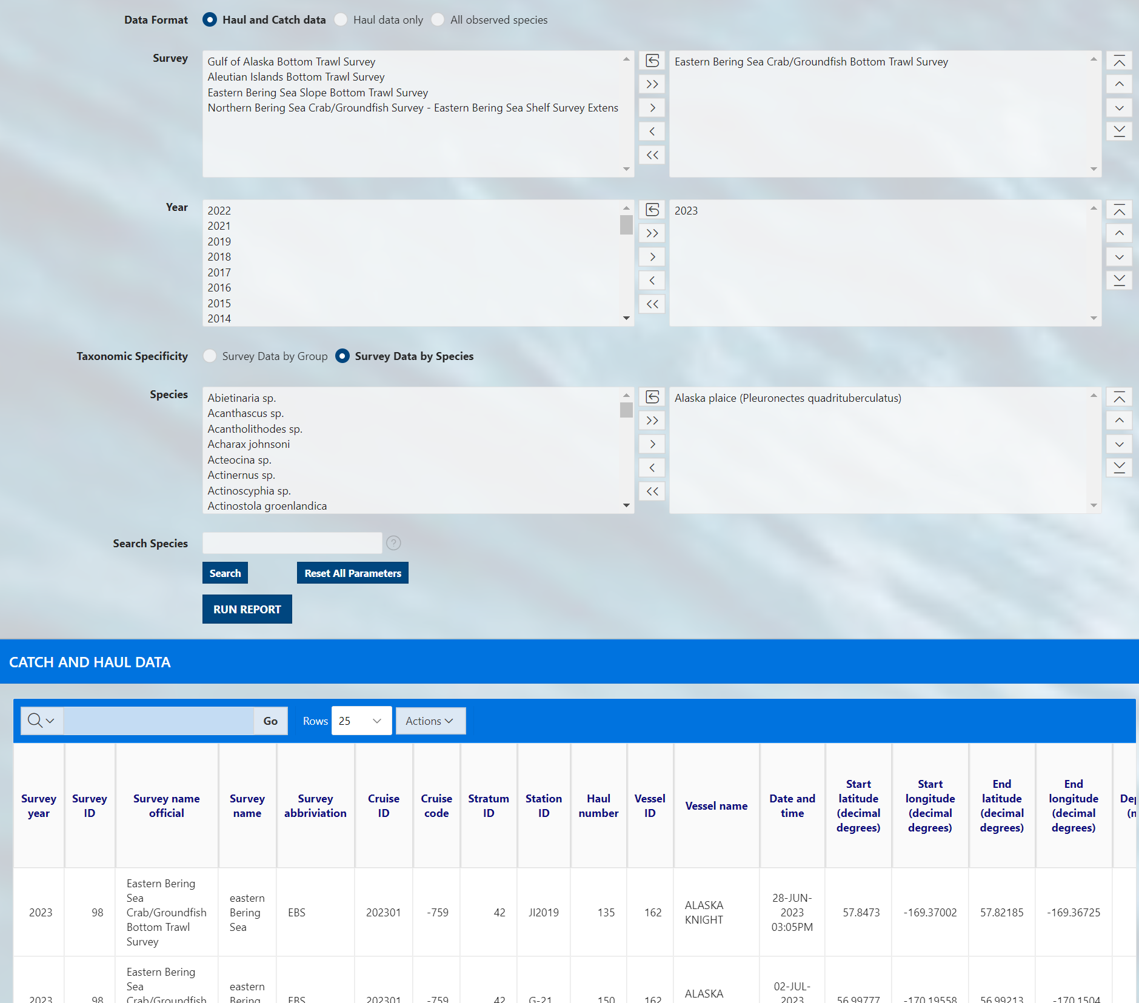
foss_1_interface_catch_select.png

Slide 15
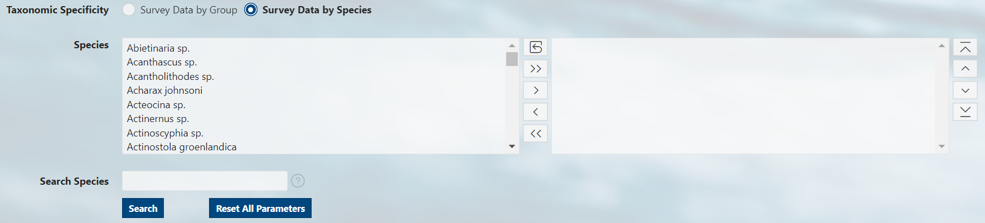
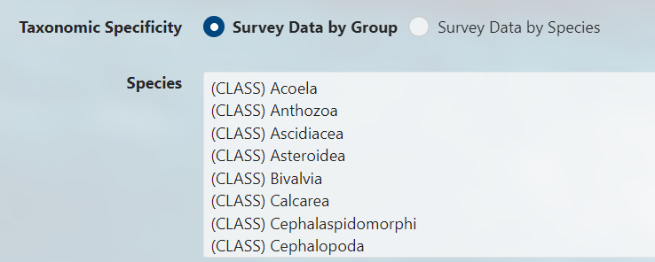
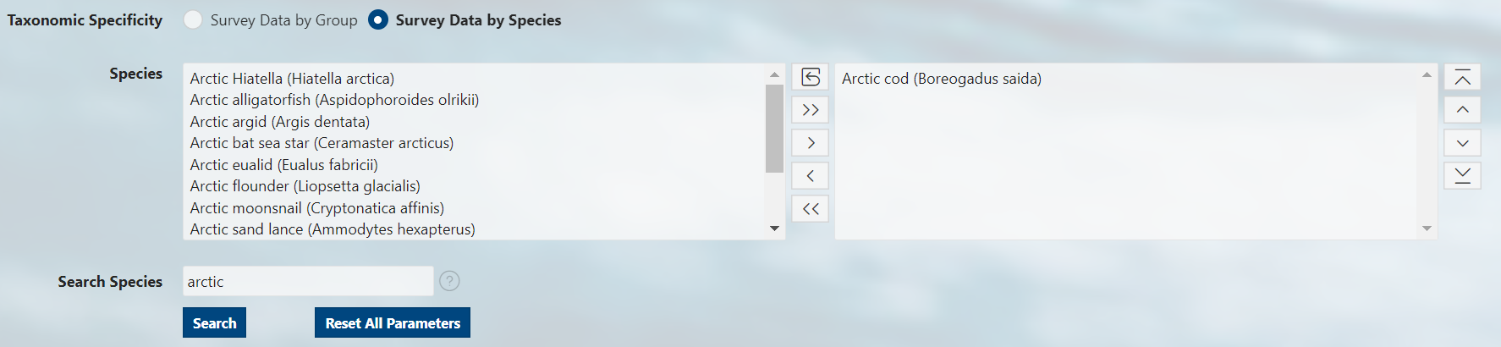
foss_2_catch_select_species.png
Options box
Select how to search through species data
Selection box
Reset box options and selections boxes
Move all options from options box to selection box
Move specifically selected options from the options box to the selection box
Move specifically selected options from the selection box to the options box
Remove all options from selection box
Manually scroll through all options/selections
Type a term of the organism’s common or scientific name and click “Search”
Reset all parameters for entire form, not just species searches

Slide 16
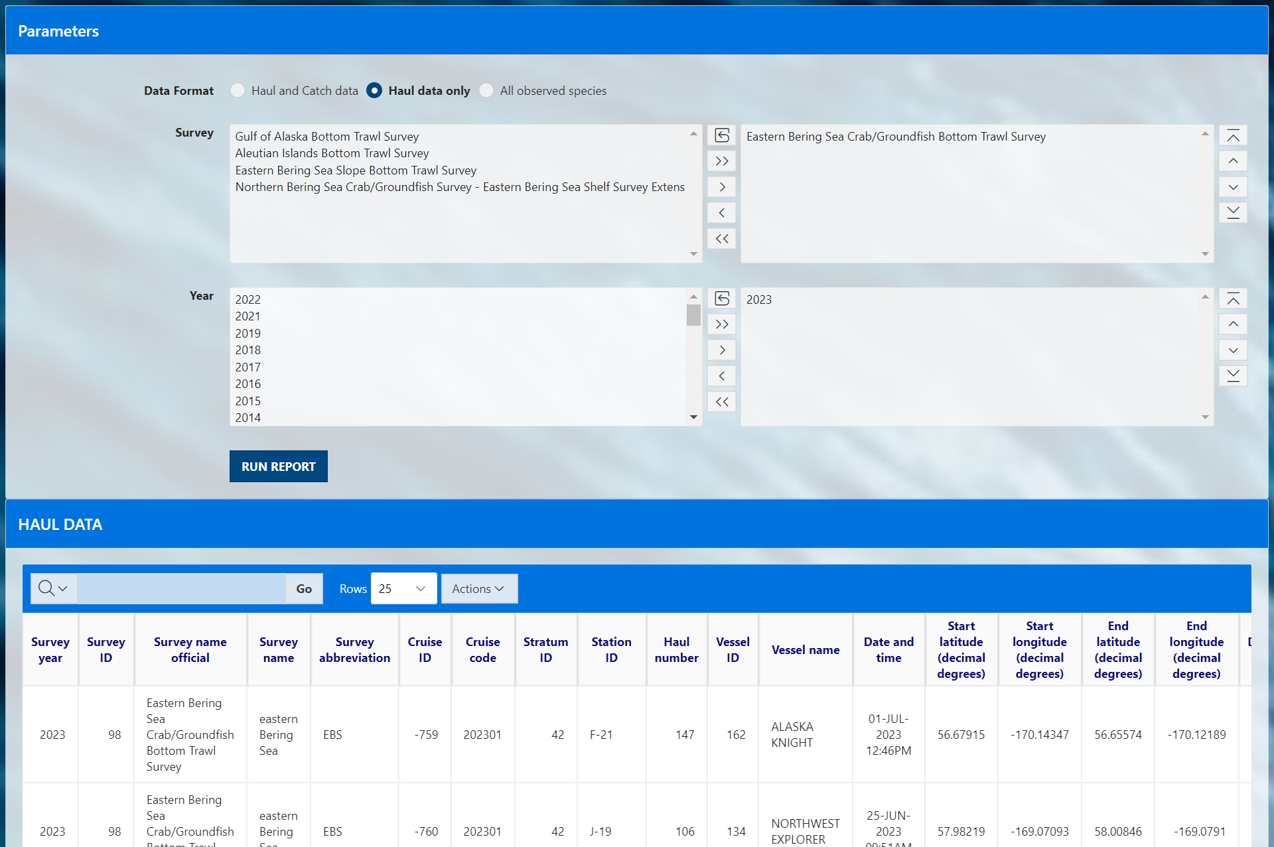
foss_1_interface_haul.png

Slide 17
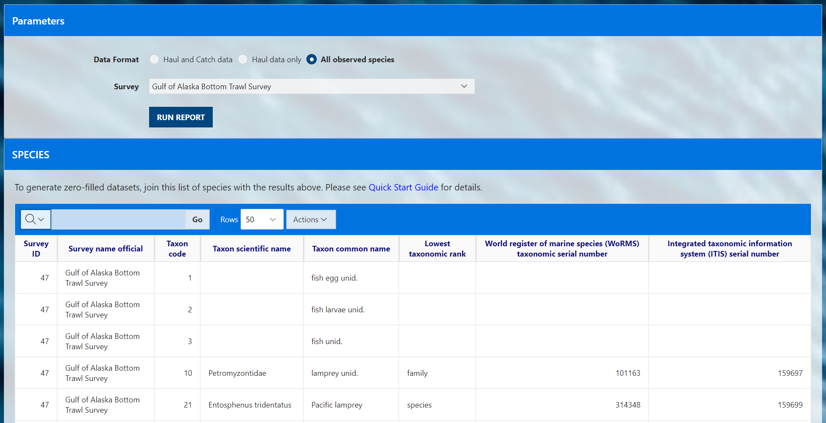
foss_1_interface_species.png

Slide 18
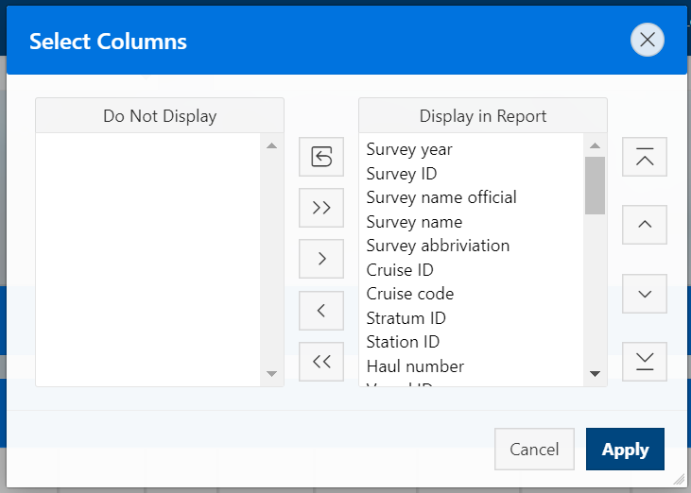
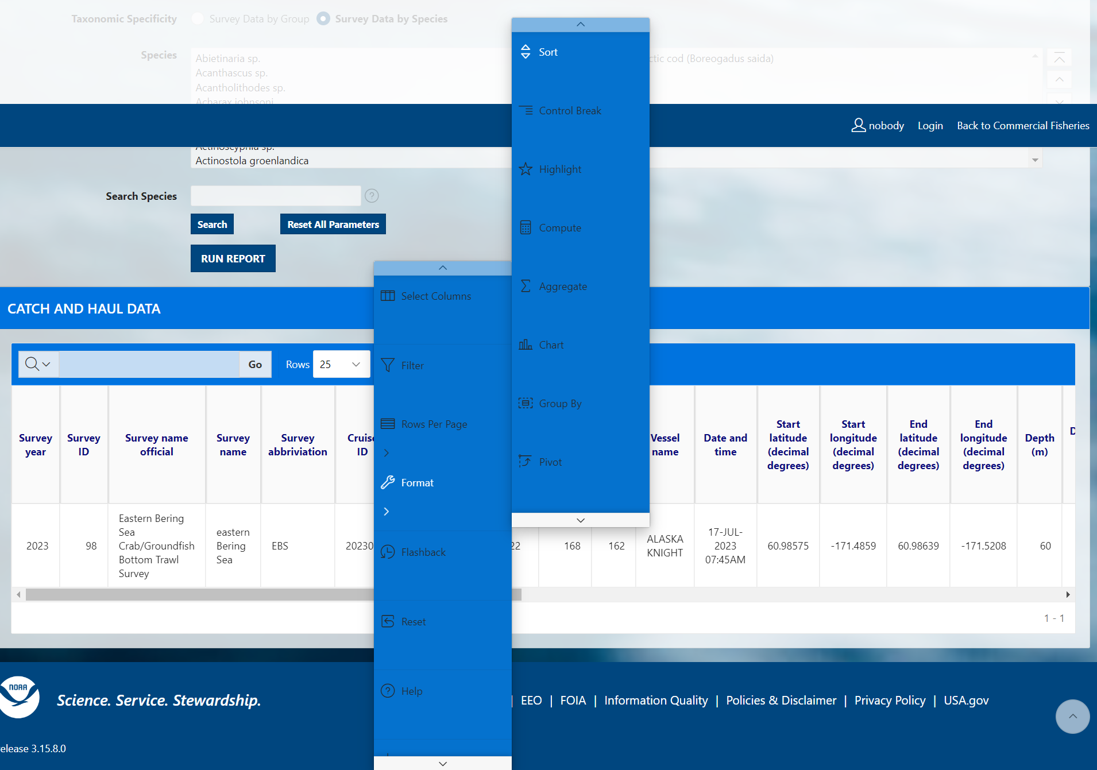
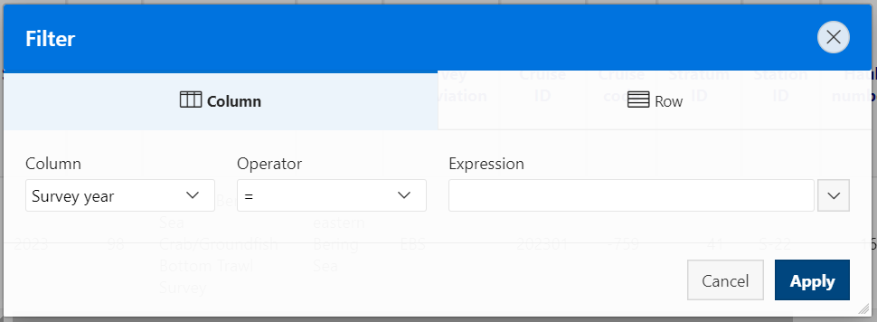
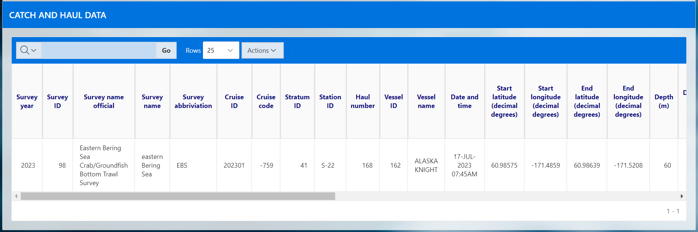
Select columns to display in your report
foss_5_run_report.png
Filter data displayed in report
Search for elements of the data
Determine how many rows per page to display
Apply mathematical aggregations to data

Slide 20
OLD
OLD

Slide 21
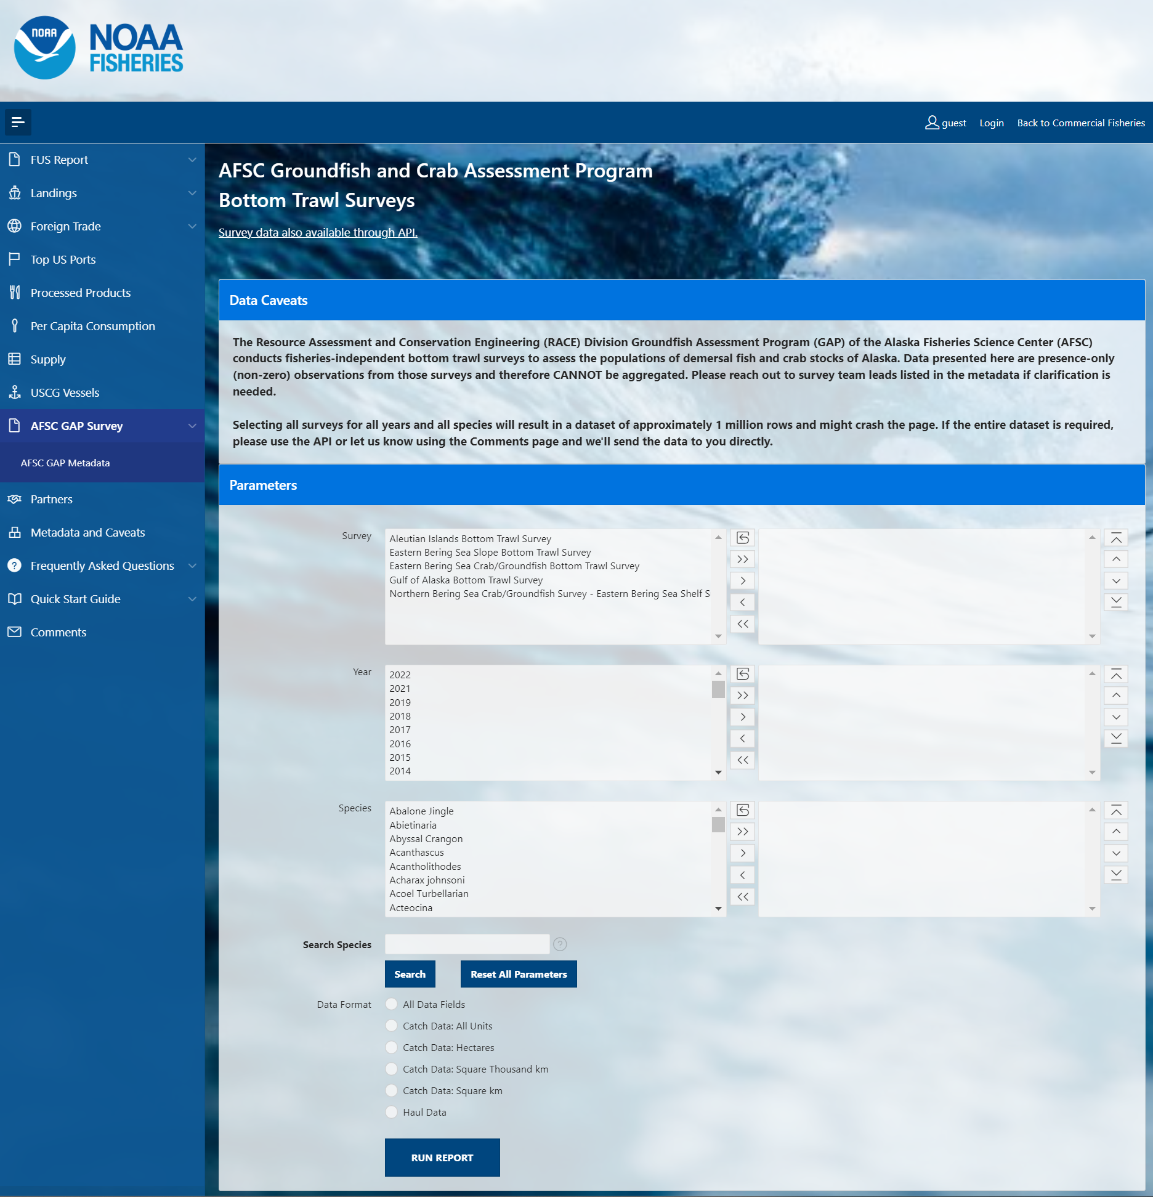
foss_1_interface.png

Slide 22
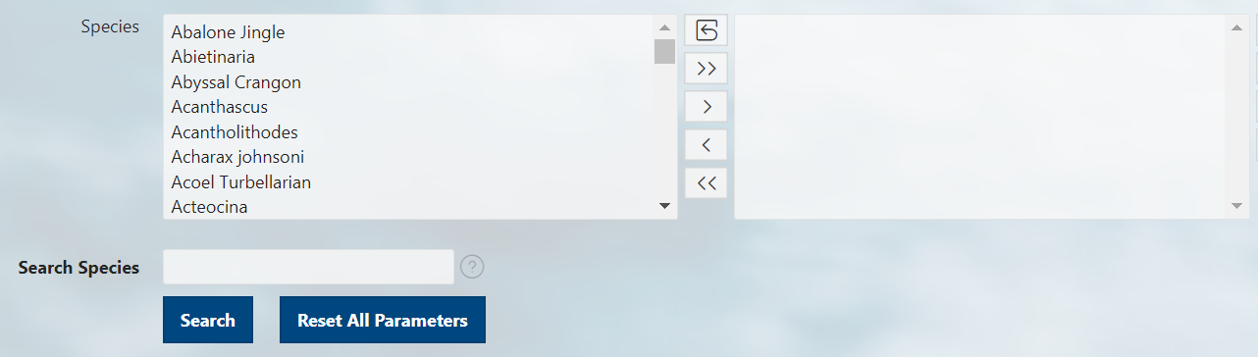
foss_2_select.png
Options box Selection box
Reset box options and selections boxes
Move all options from options box to selection box
Move specifically selected options from the options box to the selection box
Move specifically selected options from the selection box to the options box
Remove all options from selection box
Manually scroll through all options/selections
Type a term of the organism’s common name
Reset all parameters for entire form, not just species searches

Slide 23
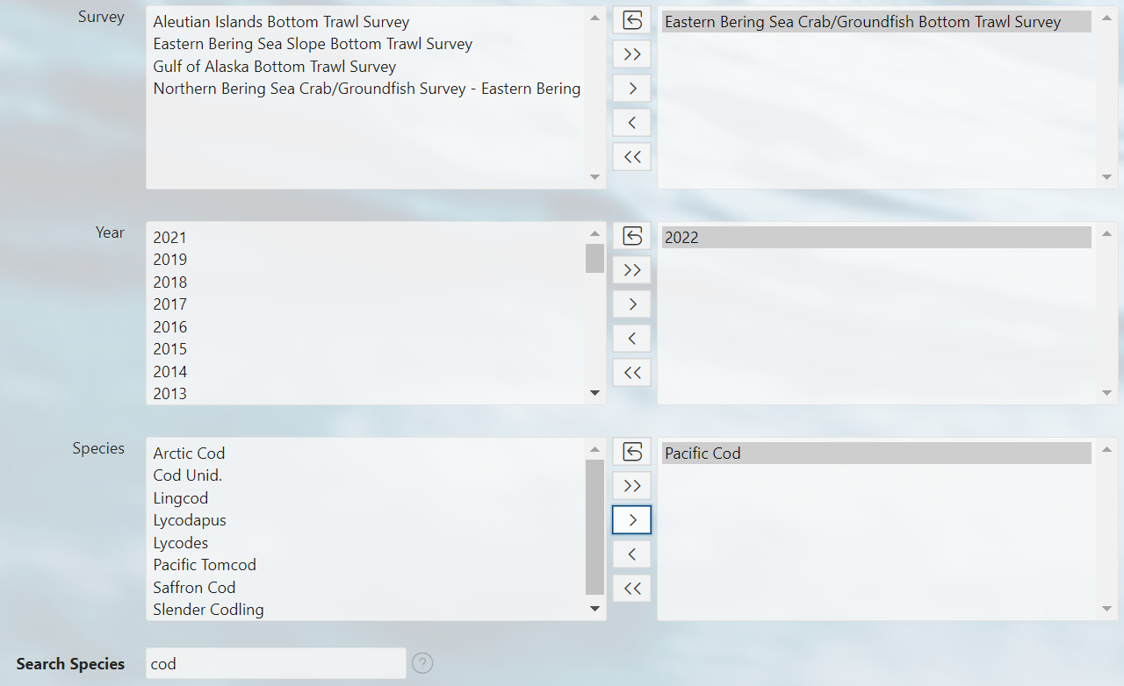
foss_3_selected.png

Slide 24
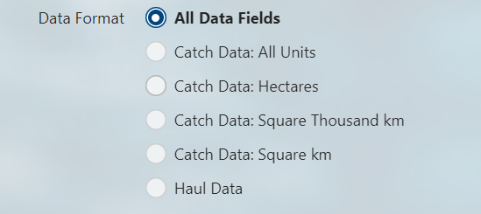
foss_4_data_format.png
All Data Fields: Presence and Absence (zero-filled)
All Data Fields: Presence-only (non-zero)
Catch data: Presence and Absence (zero-filled)
Catch data: Presence-only (non-zero)
Haul Data

Slide 25
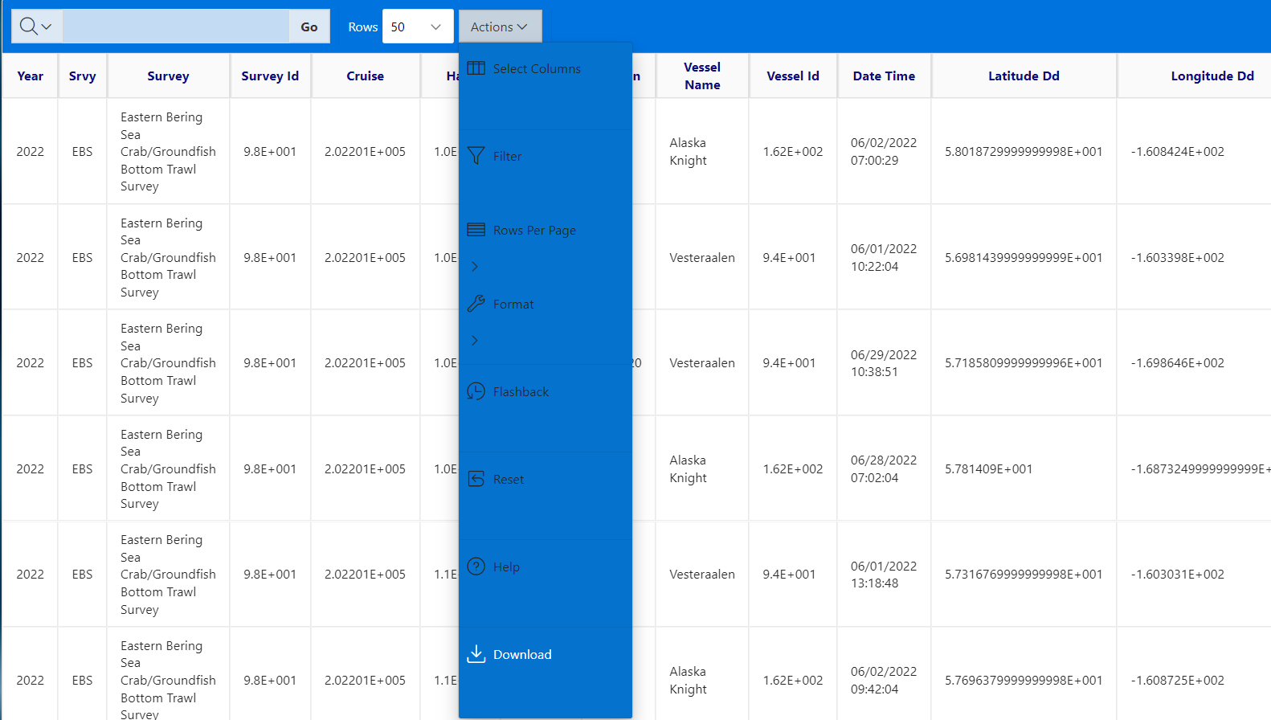
foss_5_run_report.png

Slide 27
AFSC GAP Products

Slide 28

OLD
AFSC GAP Products
AFSC GAP Products
<°//><

Slide 30
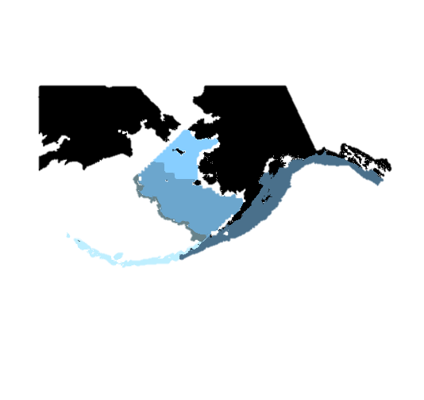





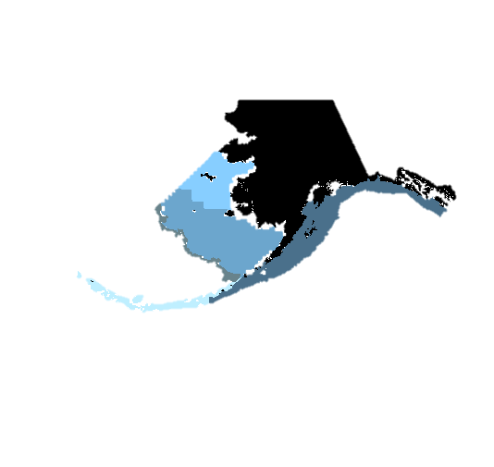



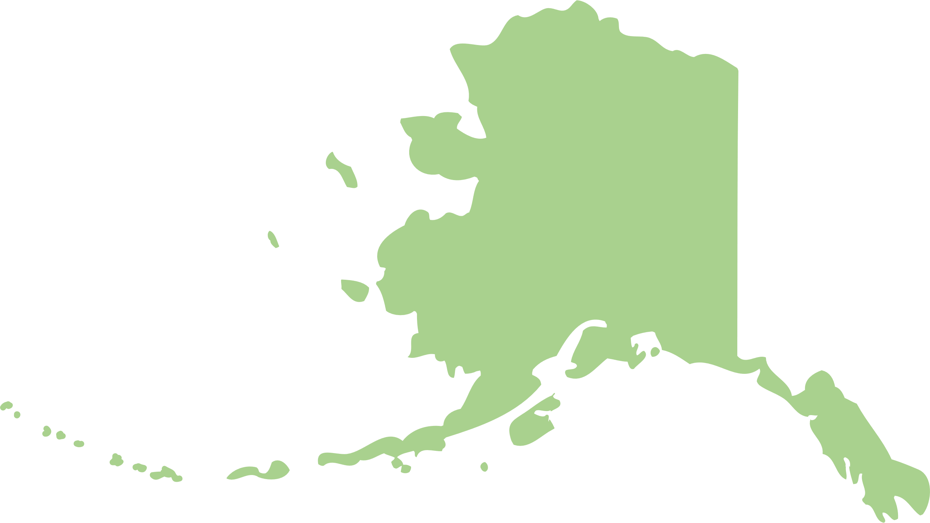
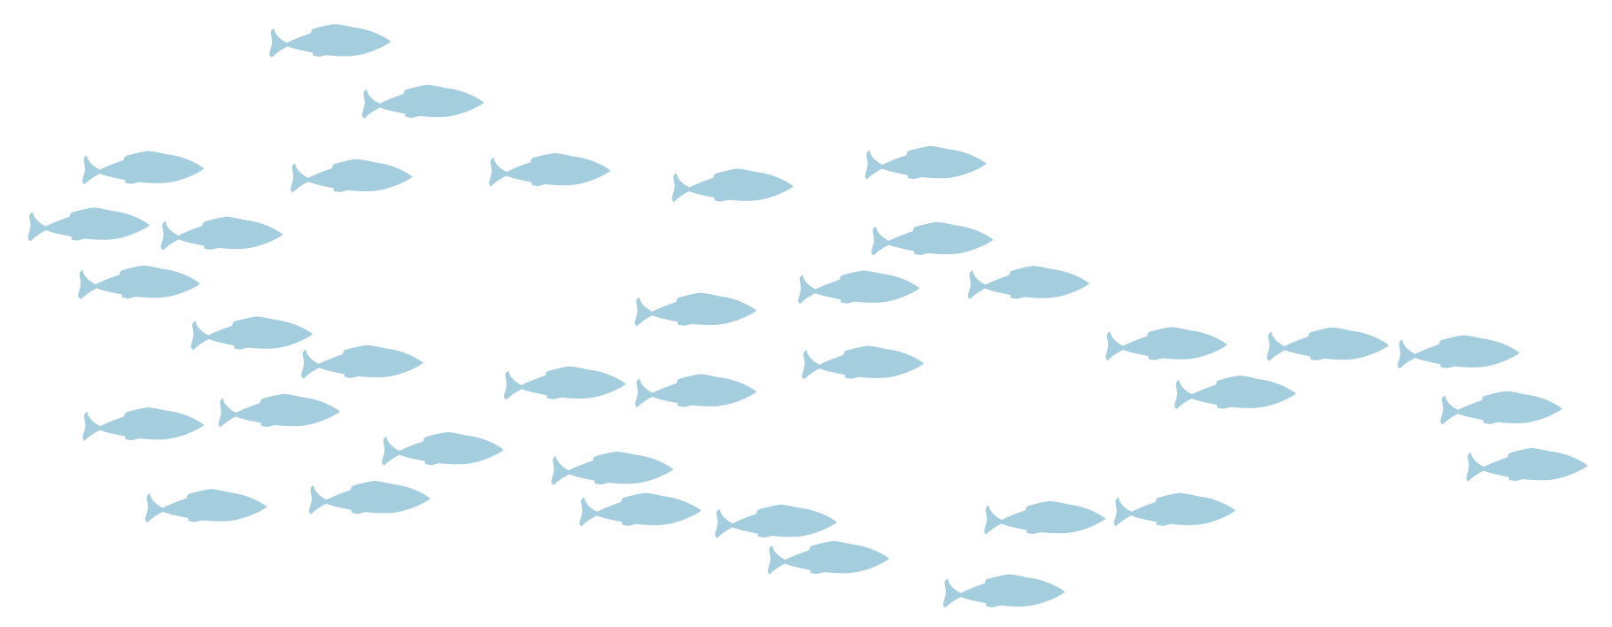

Slide 31
AFSC GAP Products
</>

Slide 33


Round Fish
Pollock
Pacific Cod
Pollock
Cod
Sablefish
Banded Sculpin
Chinook Salmon
Atka Mackerel

Slide 34
Flat Fish
Rock
Sole
Greenland Halibut
Pacific Halibut
Skate
Yellowfin Sole
Greenland Turbot
Alaska Plaice
Kamchatka Flounder
Arrowtooth Flounder

Slide 35
Rockfish
Pacific Ocean Perch
China
Rockfish
Rougheye
Rockfish
Shortspine-thornyhead
Quillback
Rockfish
Calico Rockfish
Shortraker
Rockfish
Dusky Rockfish

Slide 36
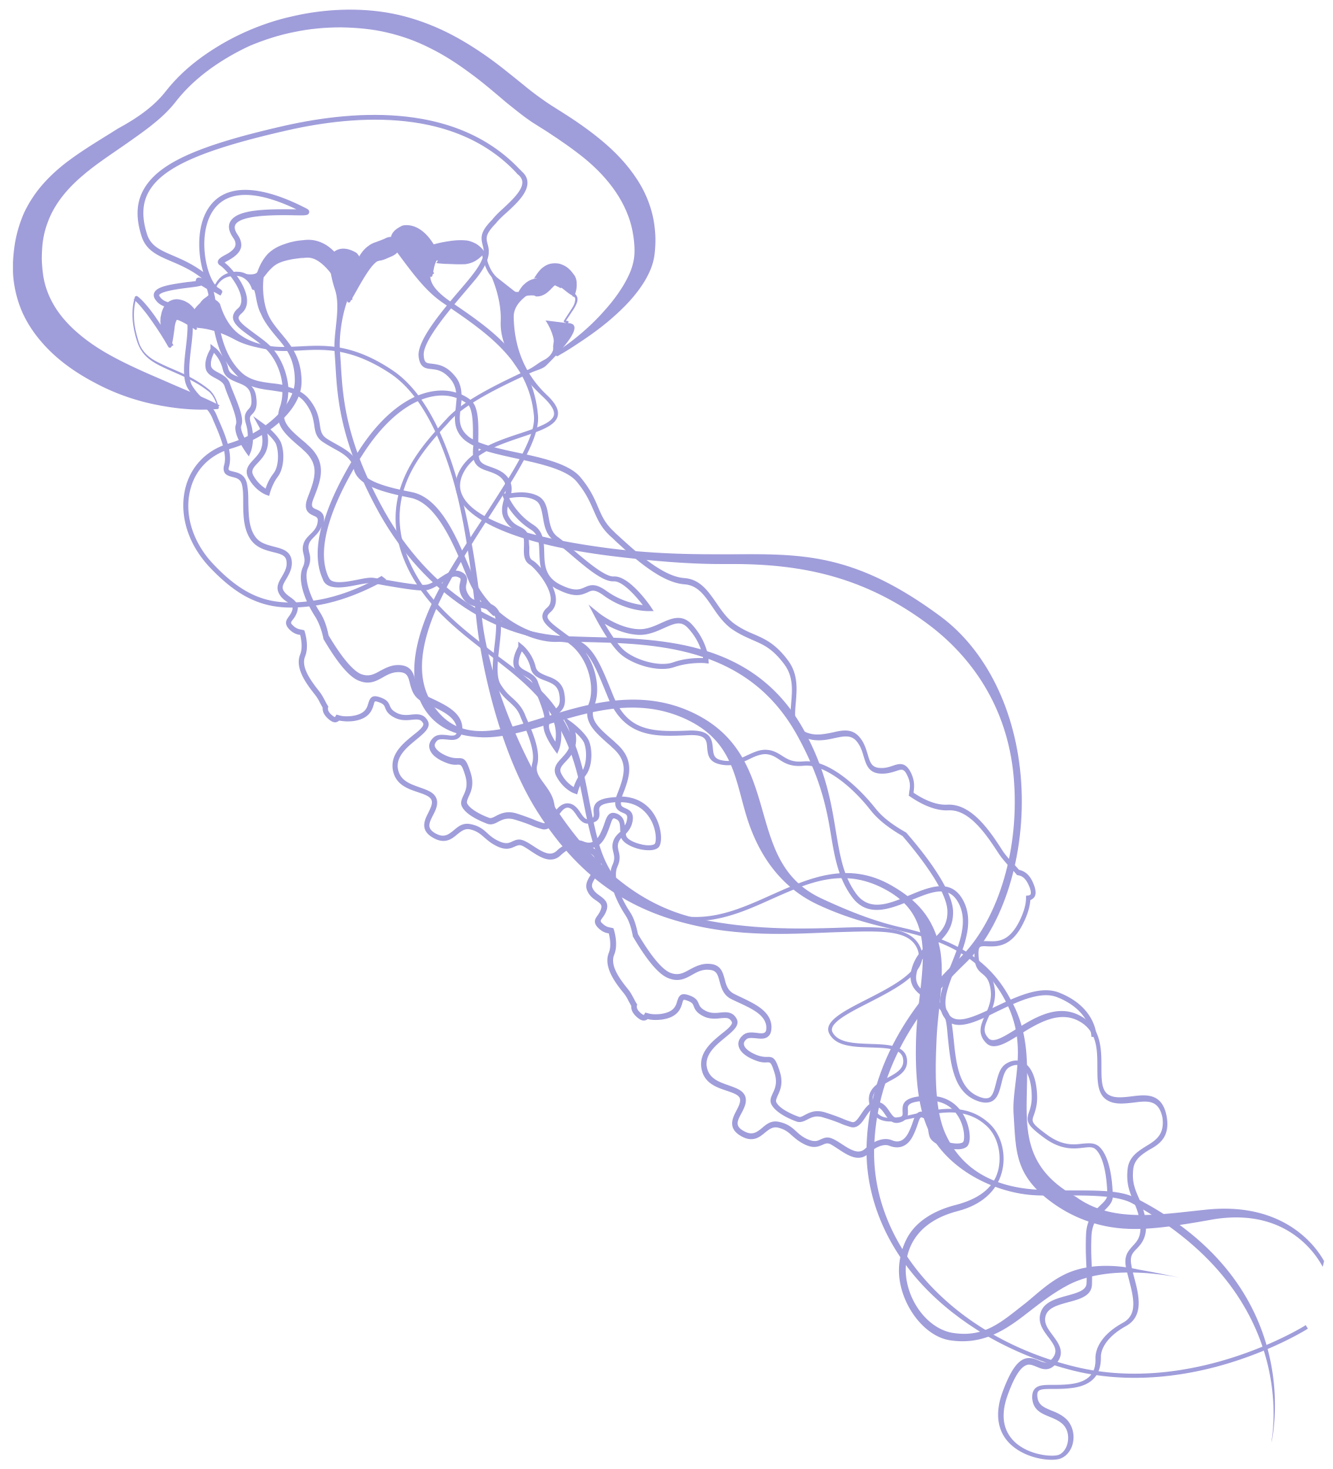
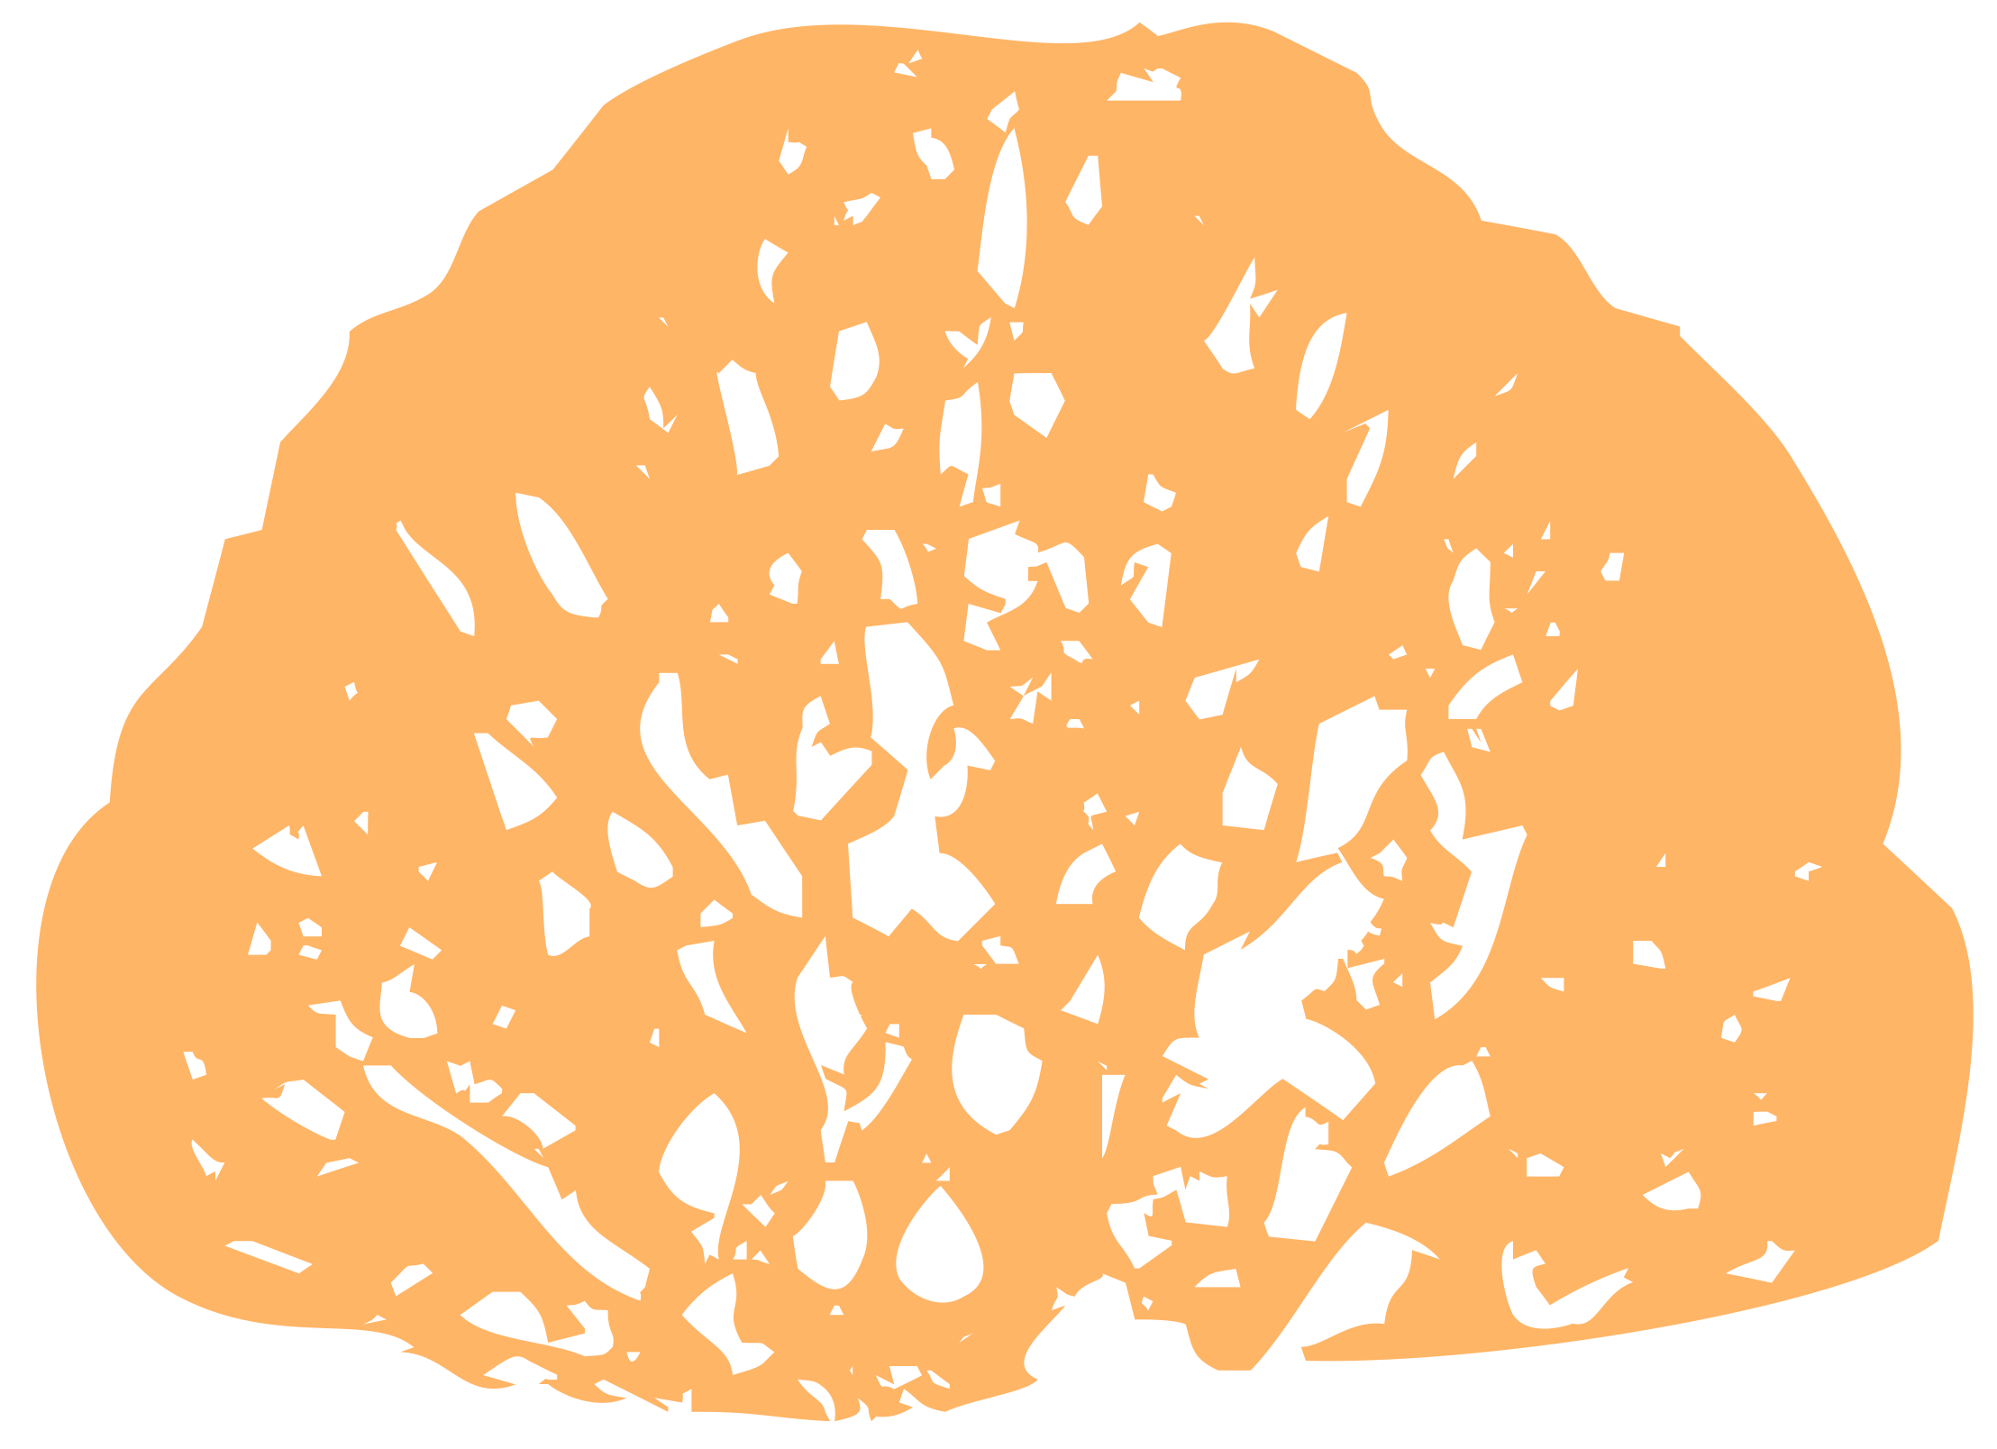
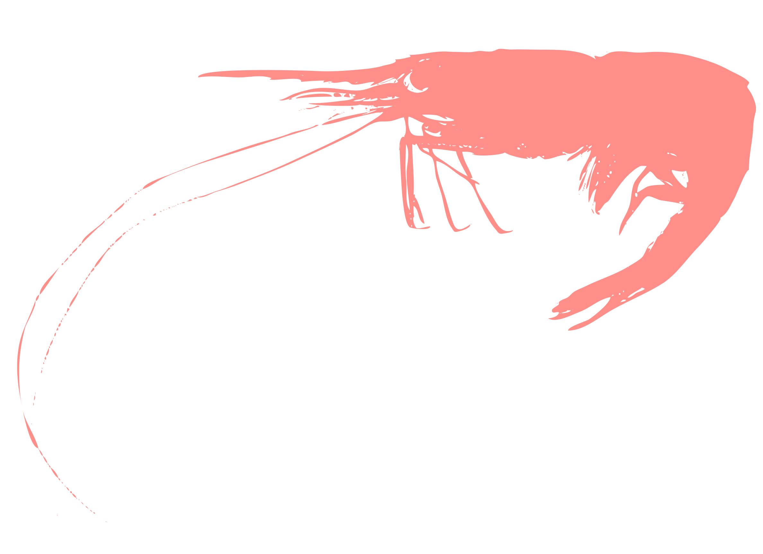


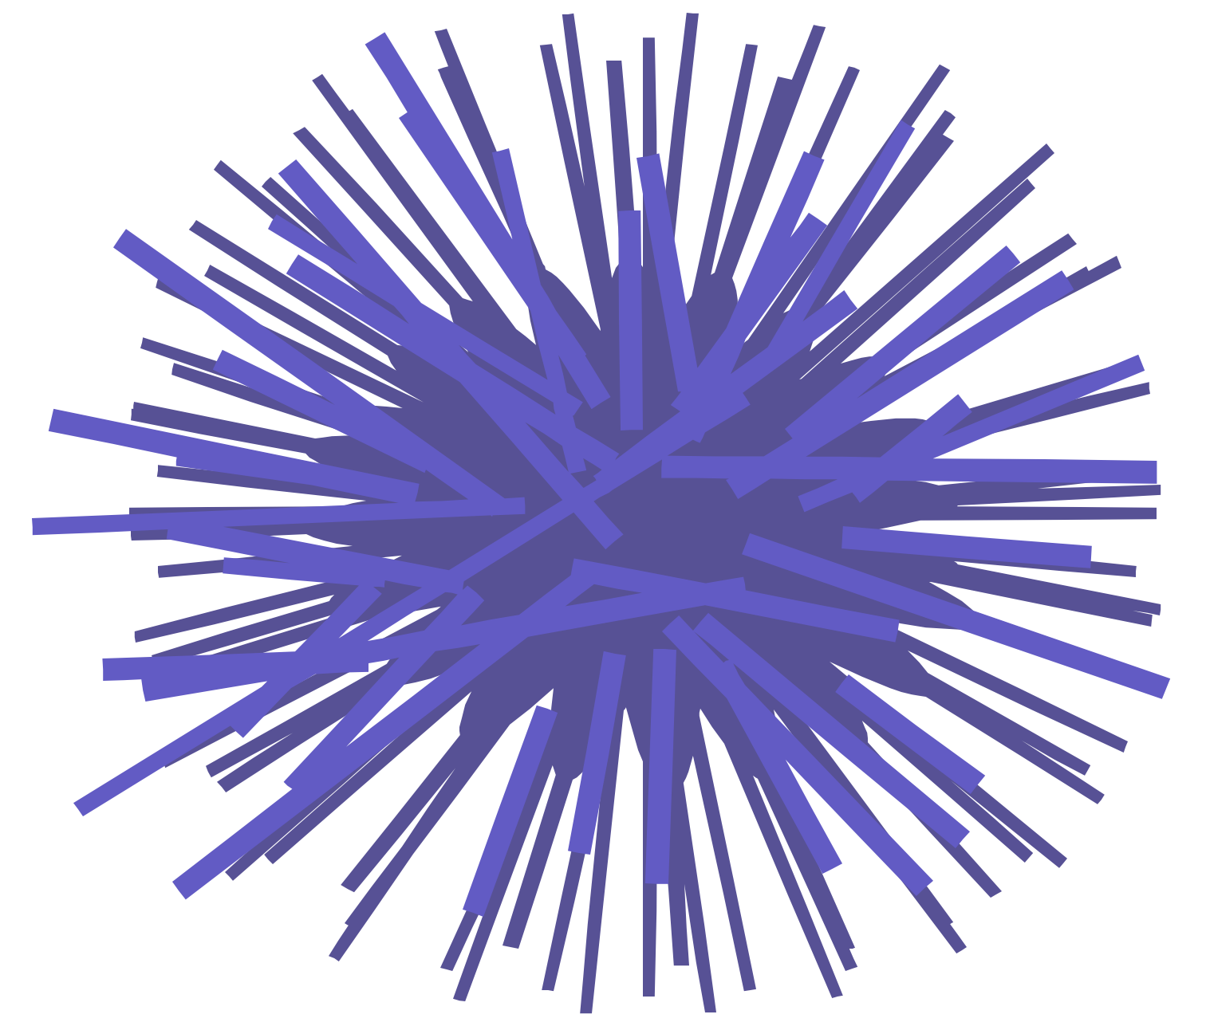

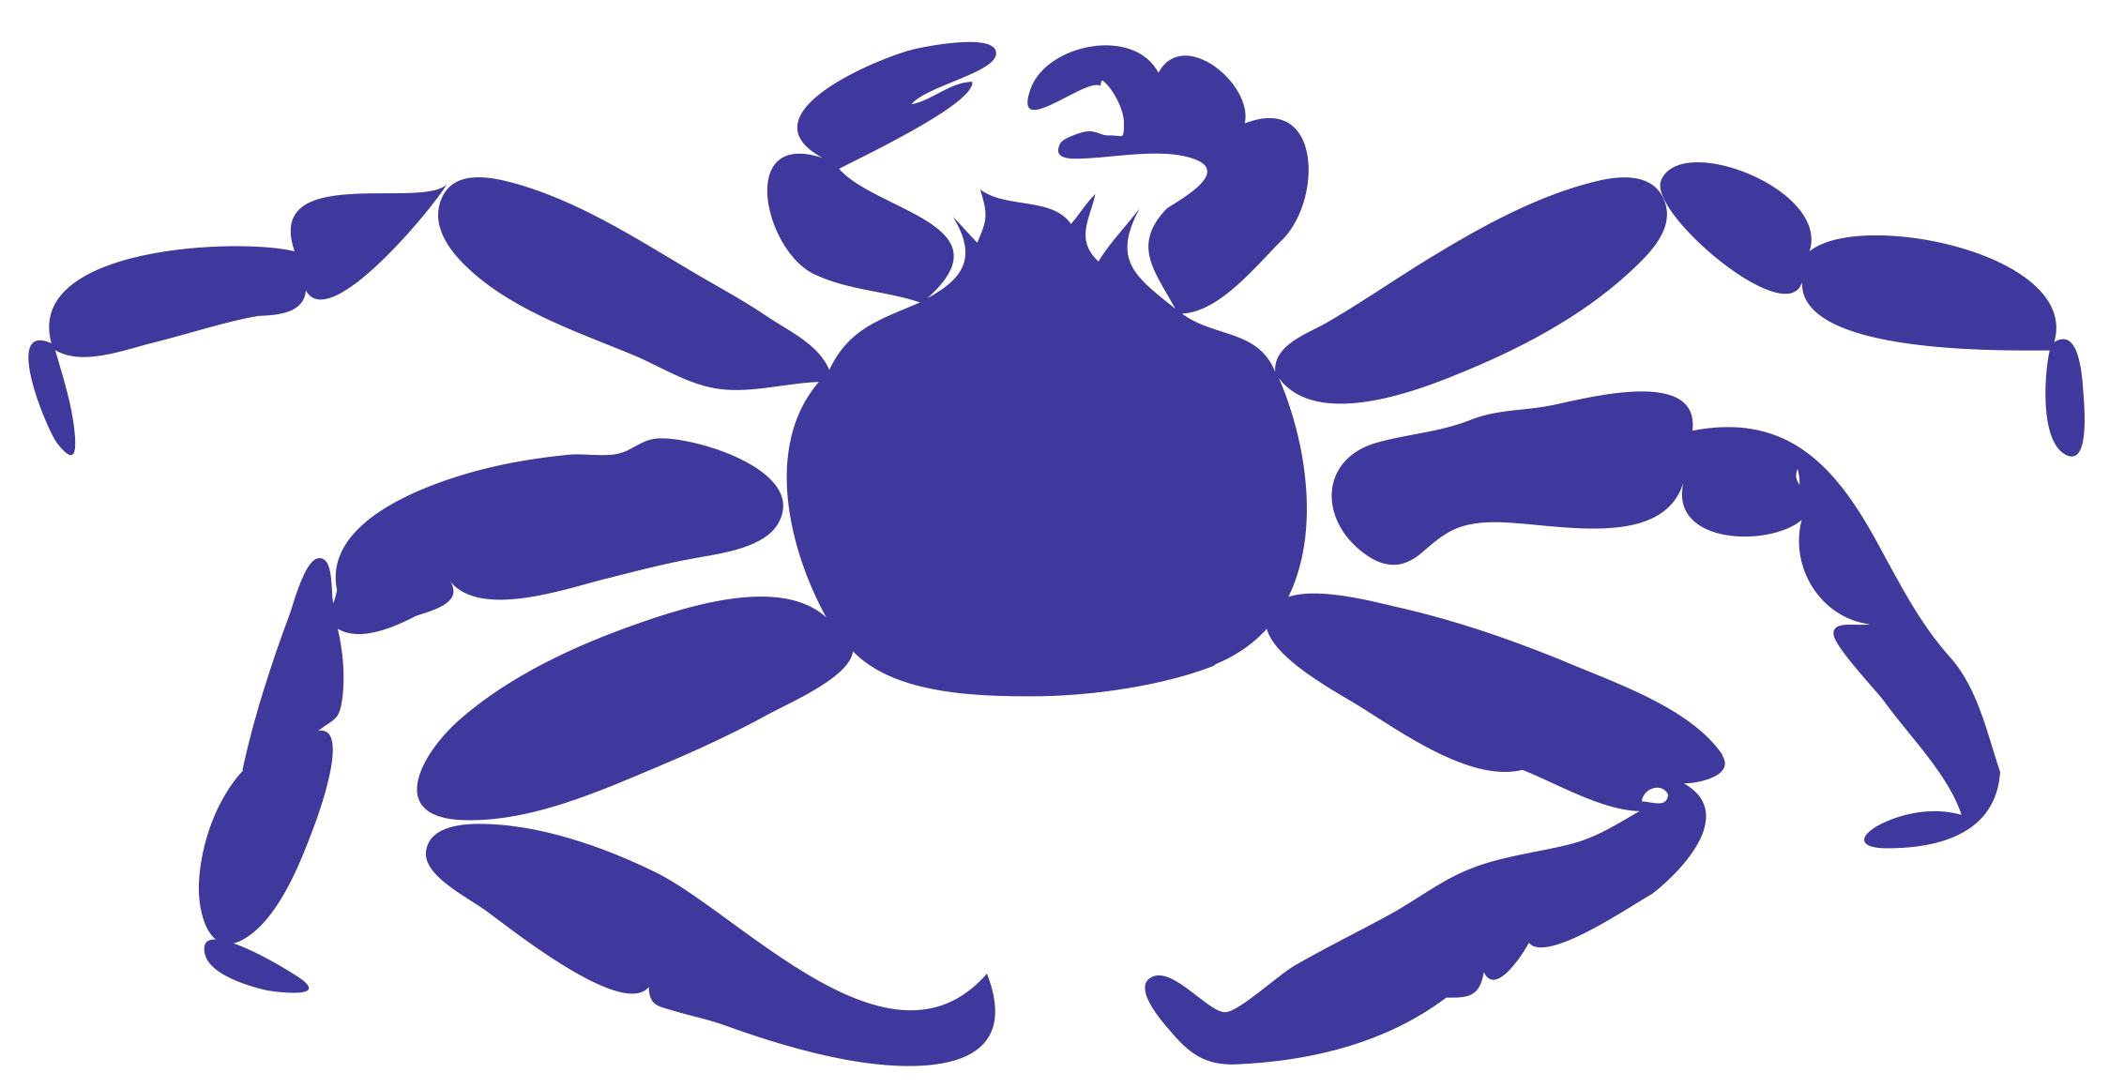

Invertebrates
Sponge
Shrimp
Jellyfish
Octopus
Squid
Alaska Snow Crab
Sea Urchin
Baltic Clam
King Crab
Pinto Abalone

Slide 37



Sea Turtles
Green Sea Turtles

Slide 38


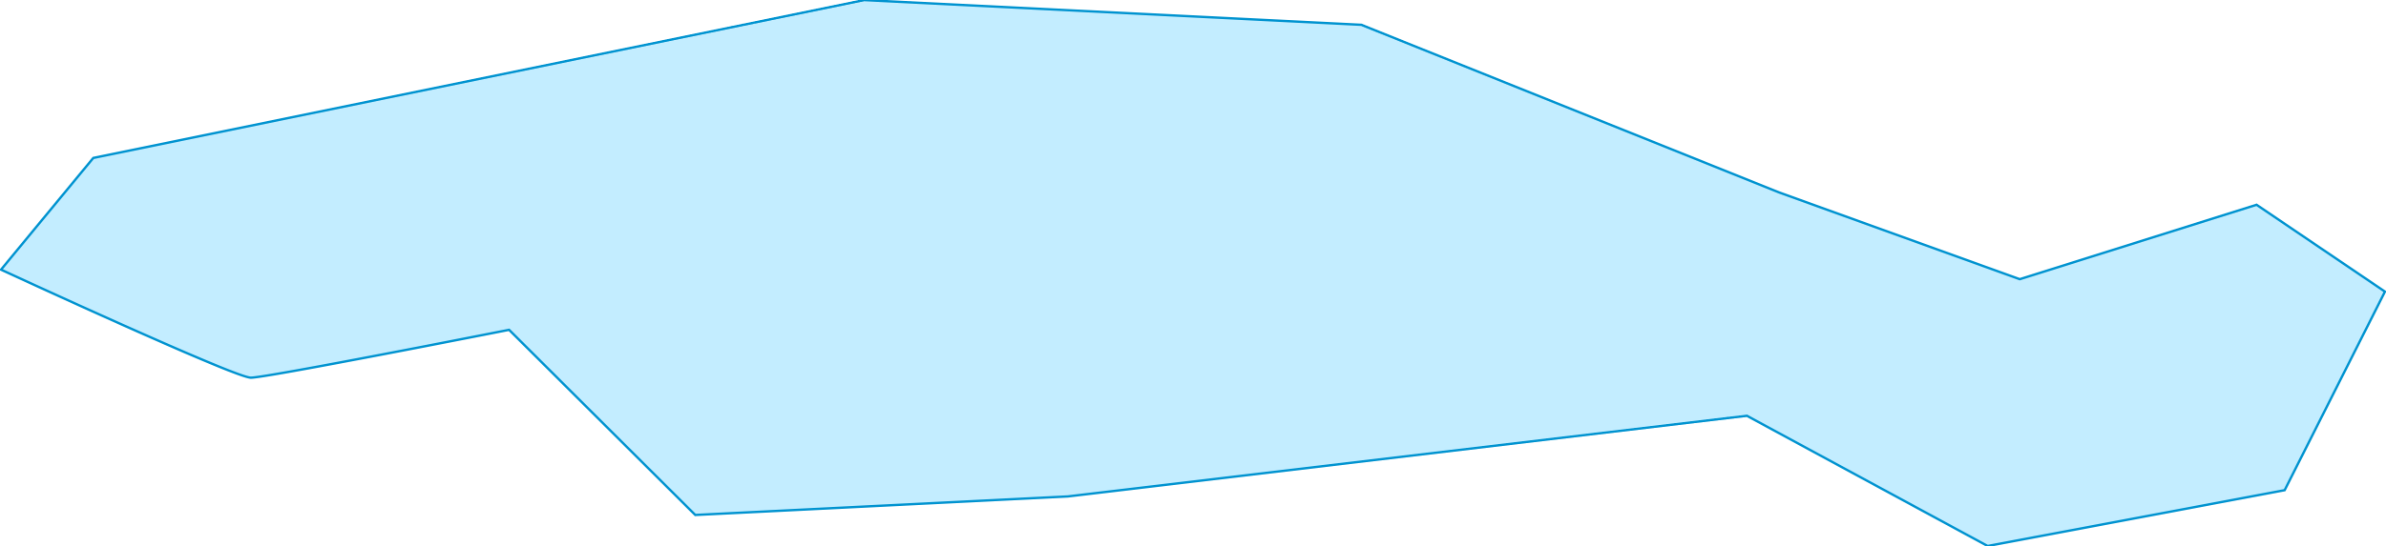
Humpback
Polar Bear

Slide 39






Seals and Sea Lions
Diving
Pup
Male
Northern Fur Seals
Steller Sea Lion
Ribbon Seal

Slide 40


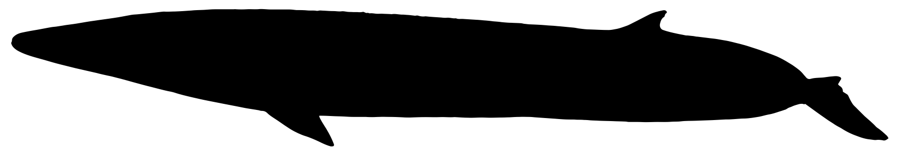
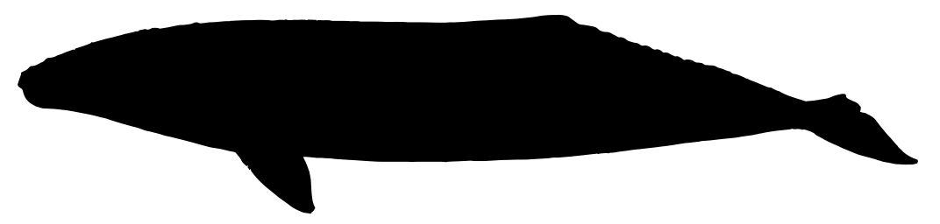

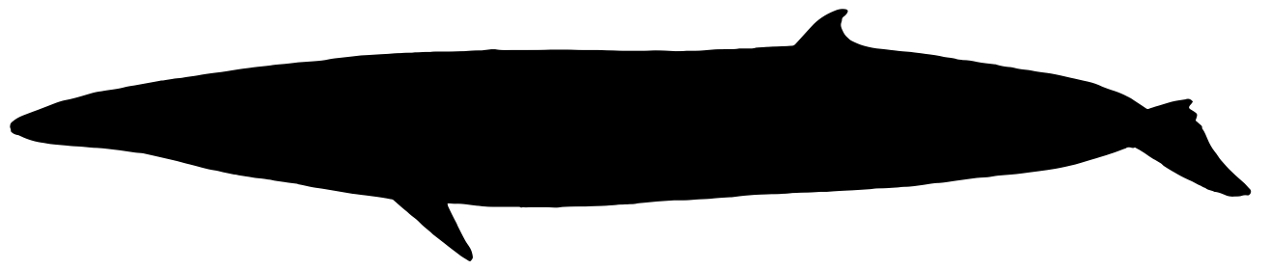
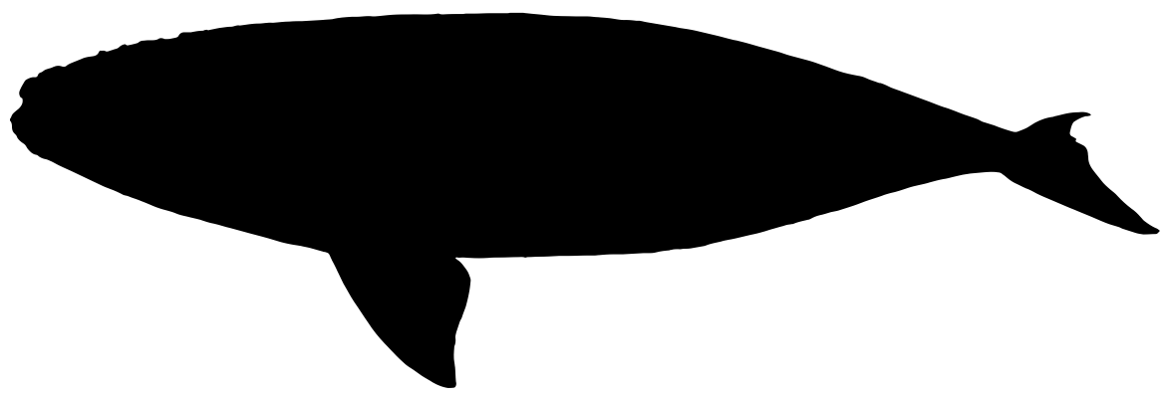


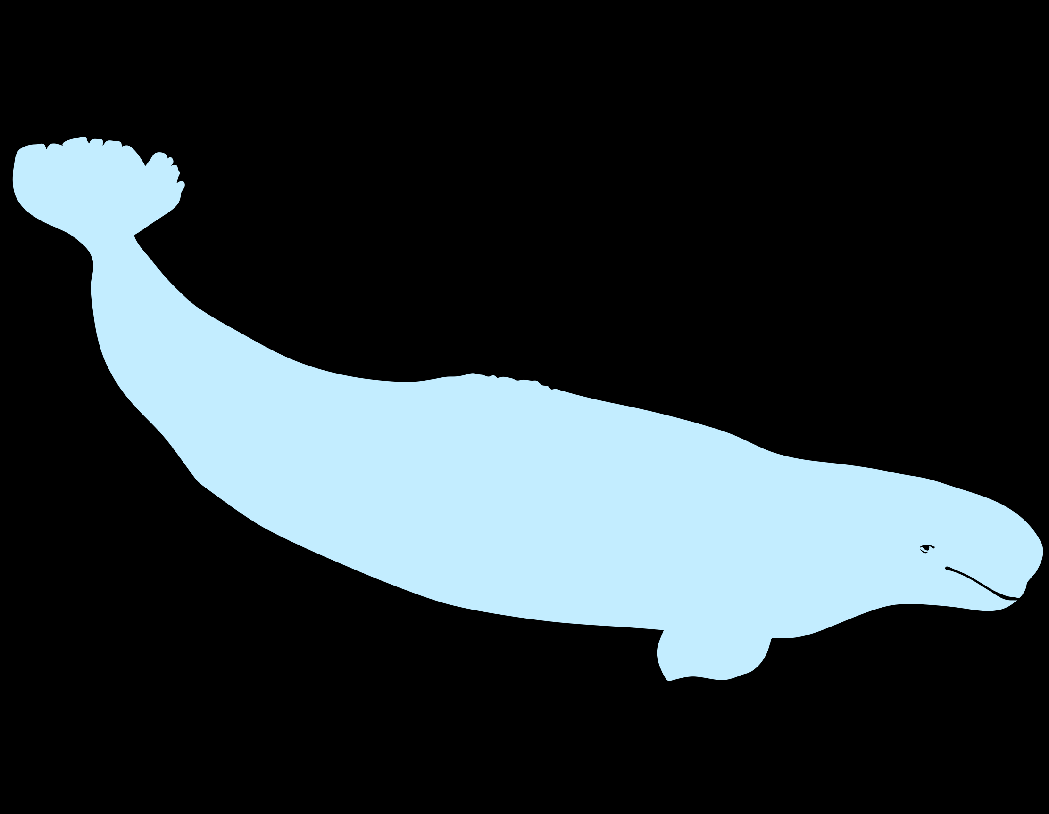
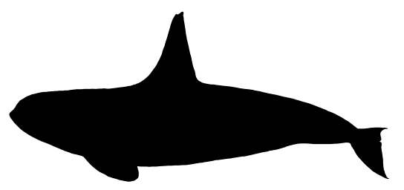
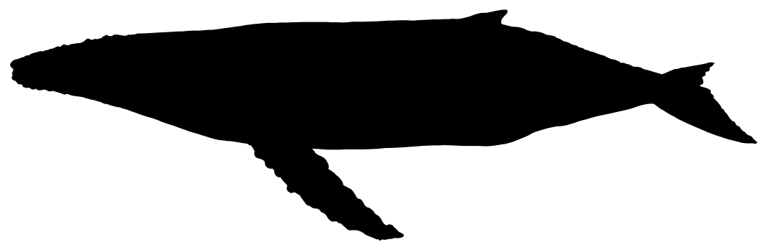
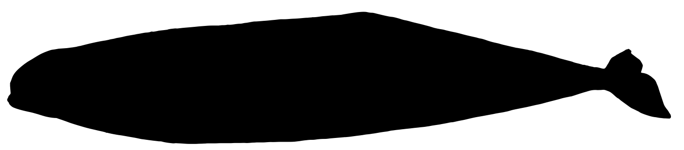
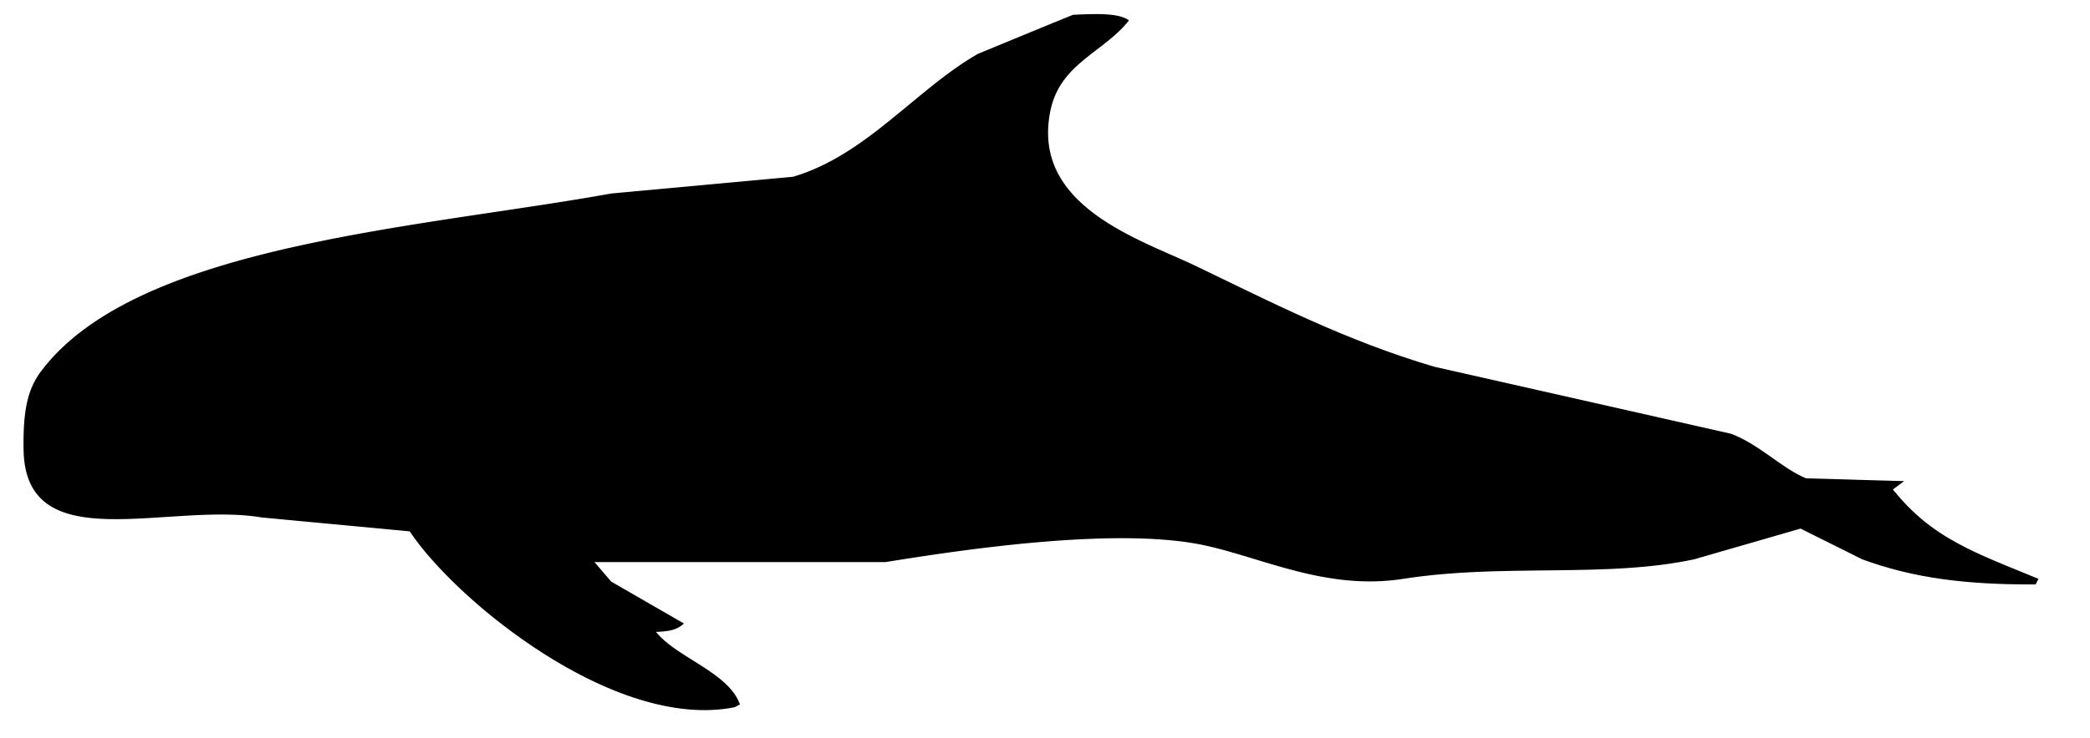
Whales
Blue
Bowhead
Fin
Gray
Sei
Fluke
North Pacific Right Whale
Sperm
Humpback
Killer
Humpback
Beluga
Beluga
Pygmy Killer Whale

Slide 41
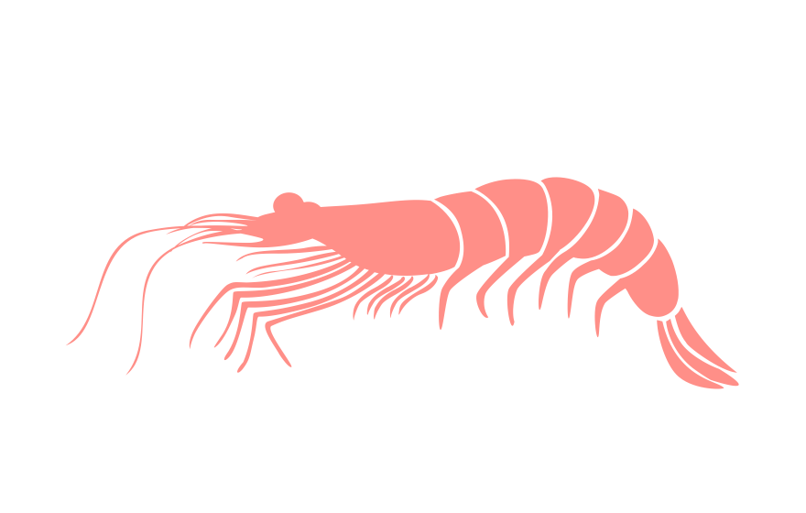

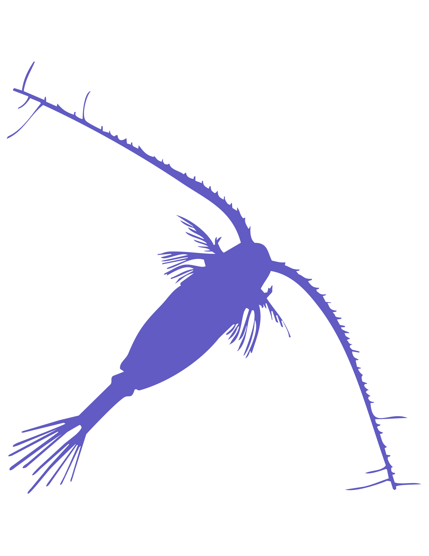


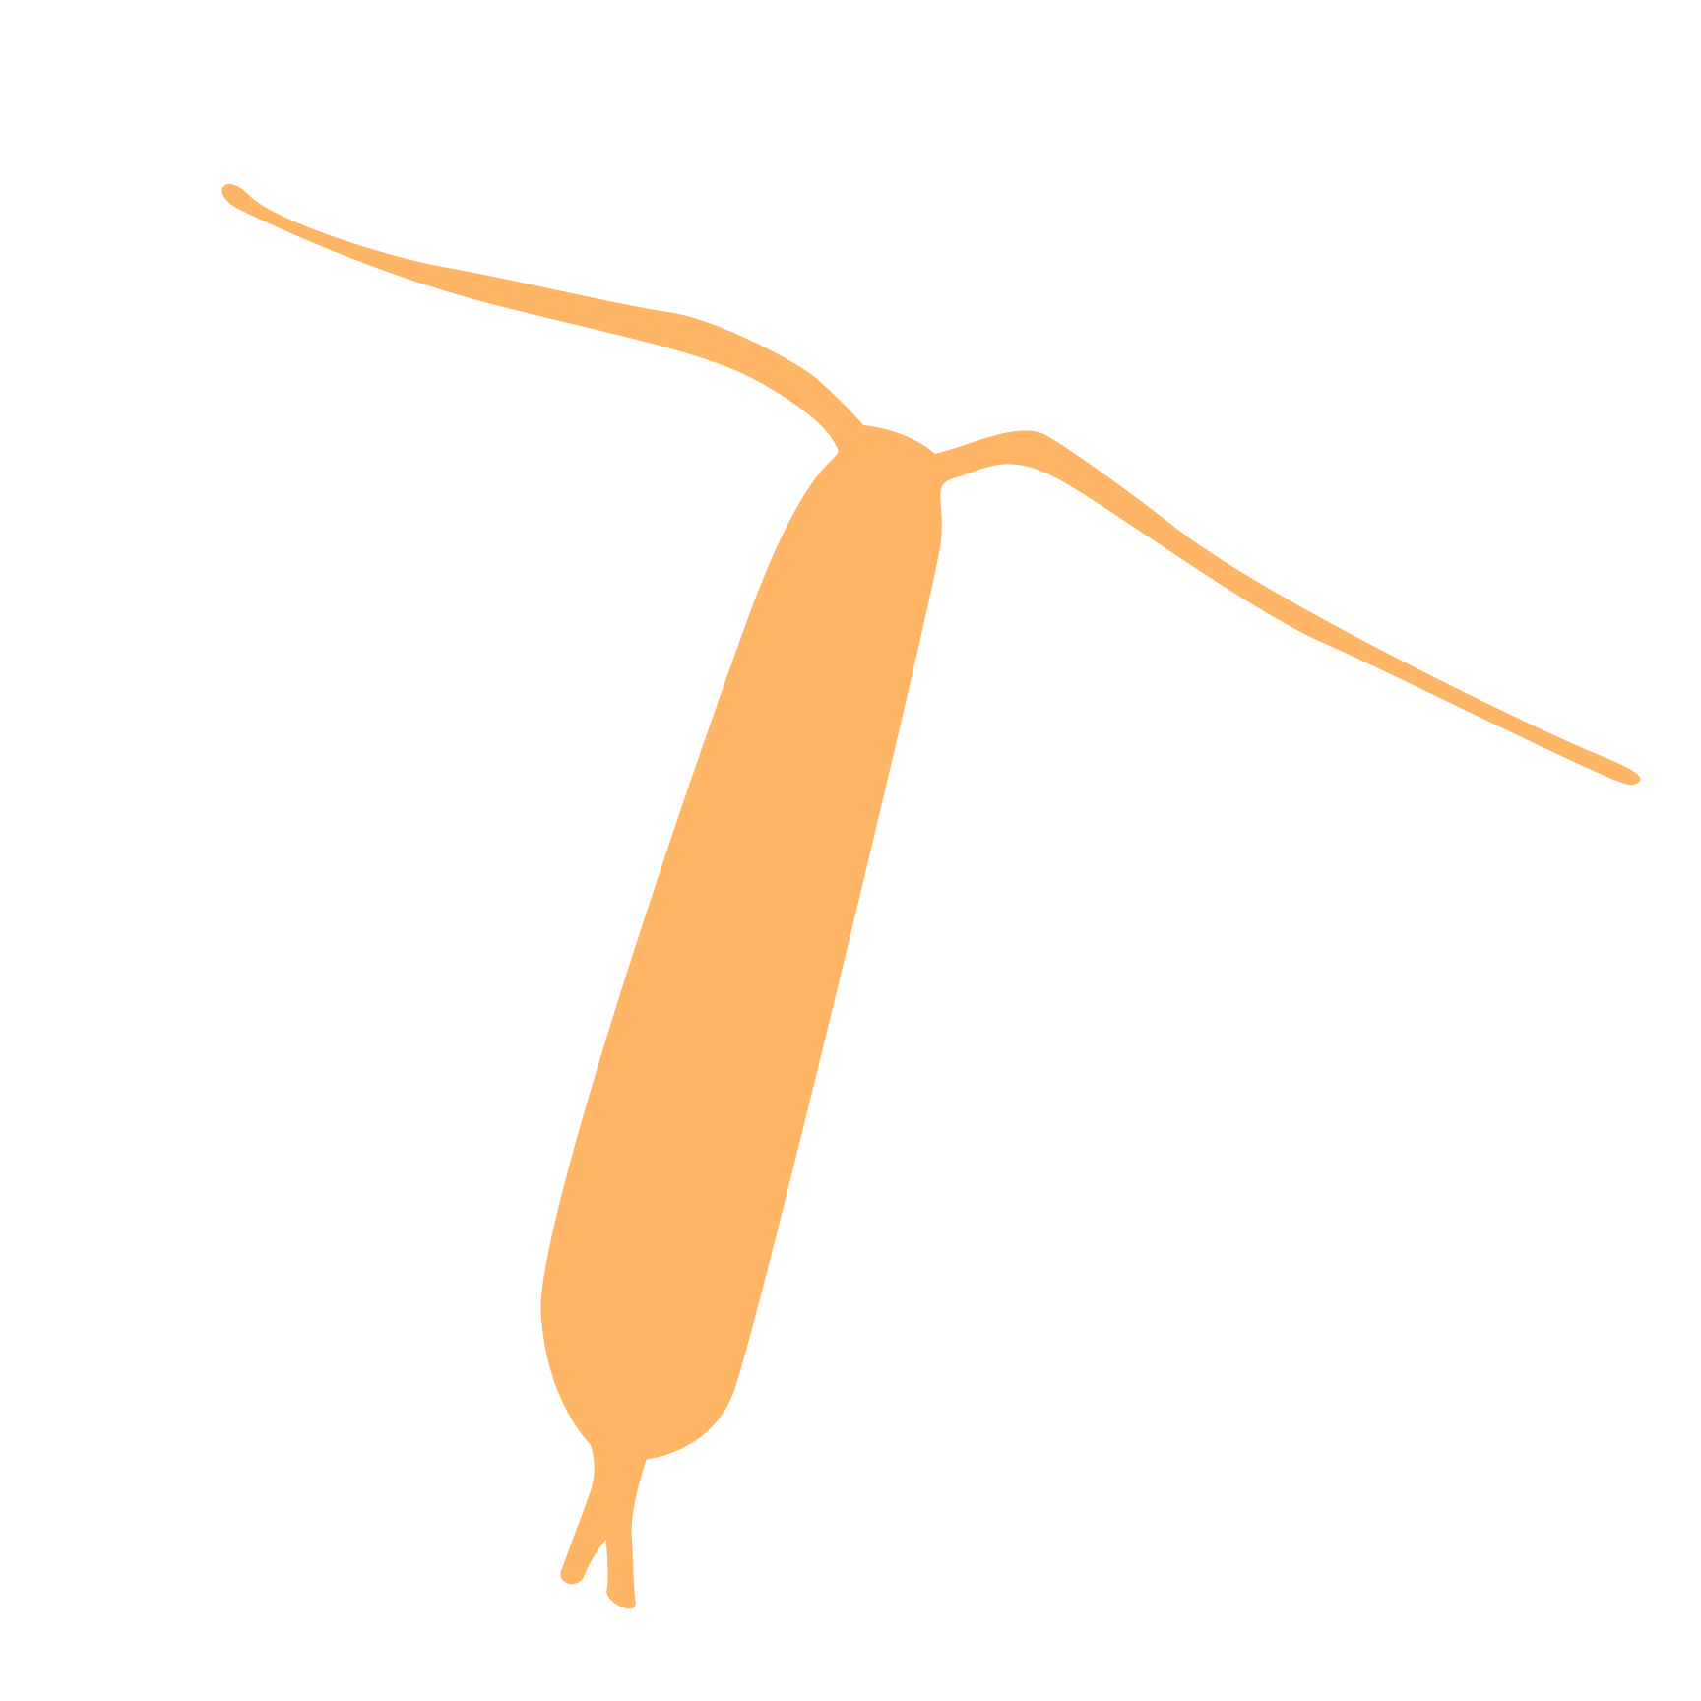
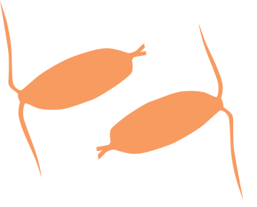
Zooplankton
Arthropod
Krill
Copepod
Euphausiid
Pteropod
Copepod [simple]

Slide 42










Birds
Fulmar
Common Murre
Short-tailed Shearwater
Heron
Eagle
Albatross

Slide 43

Ships and Gear

Slide 44





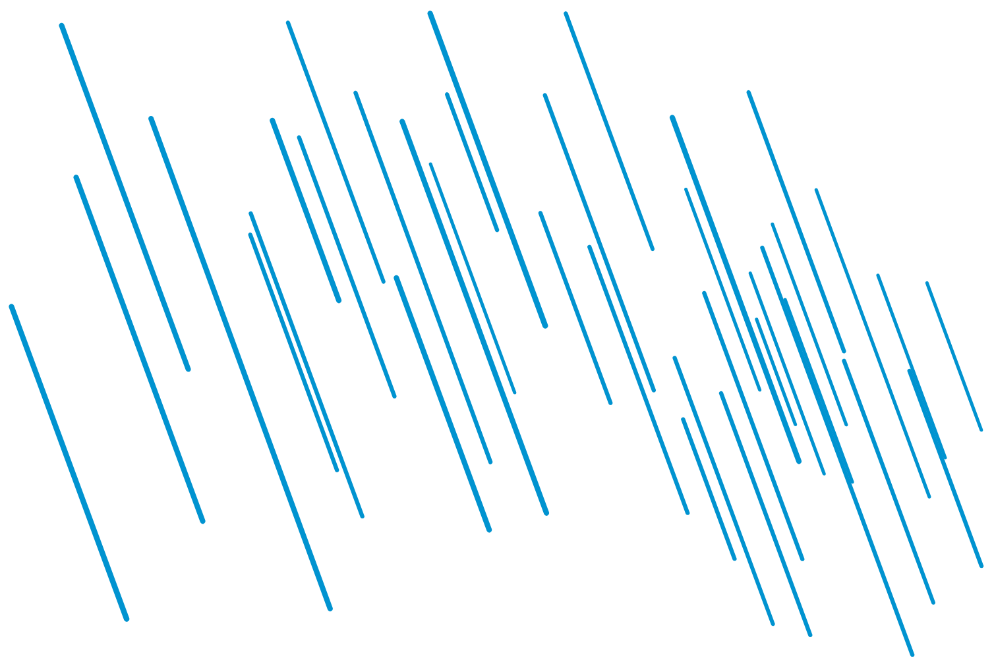








Weather and Environment

Slide 45














Research Tools, and Symbols
Fish Stomach
Fish Gonads

Slide 46














Miscellaneous Symbols
School of Fish
Generic Fish
Otolith
Bullhorn
Restroom
Signal/Acoustics
Money
Female & Male Symbols
Pen/Check Box
Award
Particles

Slide 47







Buildings and Vehicles

Slide 48





Icon Collage

Slide 49







Collage with Transparent Shapes

